Slide 1
Past is Prologue Mexican Rule and Texas Revolution

Slide 2
Dear Educator
Thank you for using this resource and for all that you do every day in your classroom. The purpose of this lesson is to show how timelines can be an effective tool to organize events, identify relationships, and explore causality. In this lesson, students will explore the holistic historical narrative of the period leading up to the Texas Revolution and question why certain events are considered important and why others are lesser known.
These slides are designed to be student facing and ready to use. For teacher facing notes and suggestions, look at the speaker notes on each slide. If you would like a more in-depth lesson plan, refer to the Colonizing Texas Lesson Plan document.
We welcome your feedback as to how we can improve our services to you. If you would like to share any suggestions or comments with us, please email education@thealamo.org.
Lesson Time: 60 – 90 min
TEKs:
SS: 7.1(A), 7.1(C), 7.2(C), 7.2(D), 7.2(E), 7.2(F), 7.3(A), 7.3(B), 7.9(A), 7.11(A), 7.11(B)
Preparation for this Lesson
Print and cut Event Cards – 1 set per class

Slide 3
Focus Question What is the relationship between the different events that led to the Texas Revolution?
Notes:
Through a collaborative protocol, each student has an opportunity to have their ideas, understandings, and perspective enhanced by hearing from others. Using this lesson, students can explore the holistic historical narrative of the period leading up to the Texas Revolution and question why certain events are considered important and why others are lesser known.

Slide 4
History Events have a cause and effect.
CAUSE
Reason or Action
EFFECT
Result or Reaction
It’s a chain of events!
Notes:
Teacher Facing Notes
To transition, lead a group discussion about causality. History doesn’t happen in isolation. Historical events have a cause and effect. Use examples and ask students to identify potential causes to major events in history they may already be aware of. Examples might include: The American Revolution, the Mexican War for Independence, the American Civil War, the civil right movement, etc.

Slide 5
Let’s Practice!

Slide 6
The American Revolution Events
Cause
Effect
Colonists disguised themselves and dumped hundreds of chests of tea into the Boston Harbor.
The Intolerable Acts are passed to punish the colonists and bring members of the Boston Tea Party to trial.
Notes:
Teacher Facing Notes
Post the cause and have students discuss the possible effects.
After discussion, post the Effect.

Slide 7
The Mexican War of Independence Events
Cause
Effect
The Treaty of Córdoba is signed in 1821.
The Spanish colonies in America are free from Spain.
Notes:
Teacher Facing Notes
Post the cause and have students discuss the possible effects.
After discussion, post the Effect.

Slide 8
The American Civil War Events
Cause
Effect
The United States is divided over the issue of slavery.
Southern states tried to establish themselves as an independent nation.
Notes:
Teacher Facing Notes
Post the cause and have students discuss the possible effects.
After discussion, post the Effect.

Slide 9
The Civil Rights Movement Events
Cause
Effect
Linda Brown was required to walk over a mile to school and denied to attend a “white only” school due to her race.
The Supreme Court declares that segregation at schools was illegal.
Notes:
Teacher Facing Notes
Post the cause and have students discuss the possible effects.
After discussion, post the Effect.

Slide 10
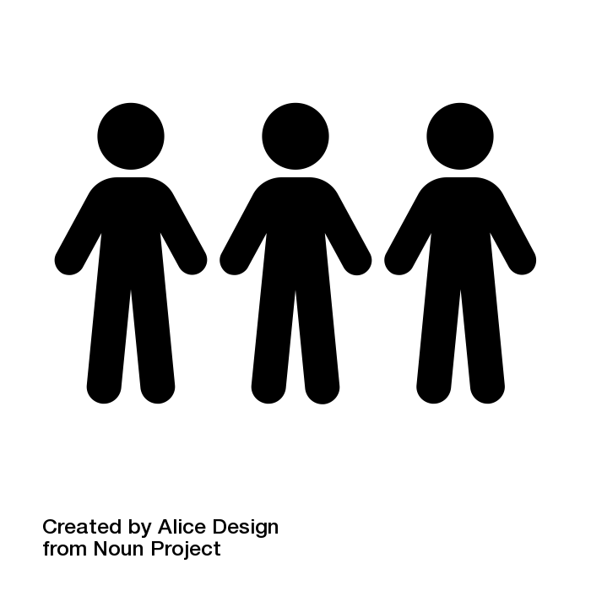
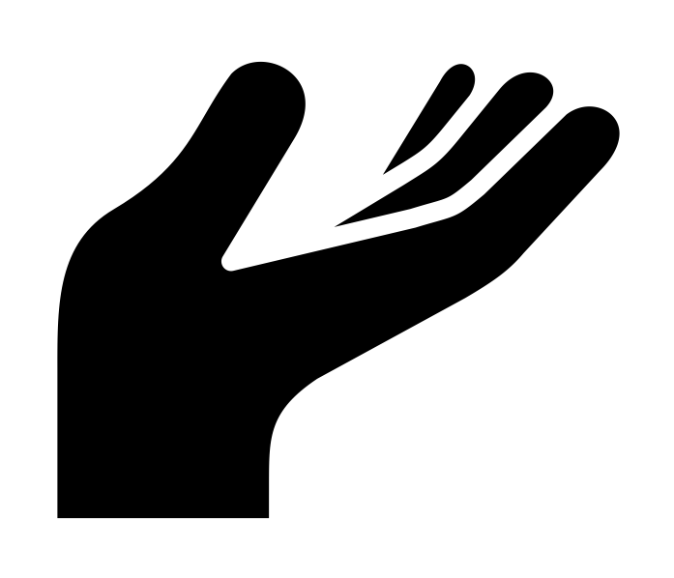
Directions
1. Take an event card and read the description.
2. Discuss your event with your classmates.
3. Place yourselves in chronological order.
Notes:
Teacher Facing Notes
Assign an event card to each student or group of students.
Students take 5-10 minutes to walk around the room, talk with other students about their events, and form a line that places the events in chronological order. Alternatively, students can post their event cards on a wall in chronological order.
Once the line is formed, students read their event cards in order from beginning to end.

Slide 11
Discussion Questions
How did surrounding events impact other events in the timeline?
How similar or different were the Mexican and Texan wars for independence?
How do these events appear to be connected?
Which are the most consequential events in the timeline? Why?
Are there any events that should be added to the timeline? Why?
Notes:
Teacher Facing Notes
Put students in small groups to answer the discussion questions.

Slide 12
Challenge
As a class, discuss which three events are the least impactful to history and remove them from the timeline.
Discuss why those events were chosen.
Notes:
Teacher Facing Notes
Remind students that history is complicated, and rarely, if ever, do historians include every possible cause, effect, event, or perspective.
Inform students that they must remove the three least important events from the timeline.
Have students discuss why certain events are more or less important than others.

Slide 13
Discussion Questions
Was there a turning point in the Texan call for independence?
Are there any recurring themes or values represented in the events leading up to the revolution?
How should historians decide which events to include or exclude when creating historical narratives?
Notes:
Teacher Facing Notes
Once students have removed the three events, continue the class discussion using the discussion questions.

Slide 14
Optional Enrichment/Extension Activities
Biography Project: Give students a biography card from the lesson and have them create a poster or multimedia project that would help others understand the chosen individual and their contribution to Texas Independence.
Analyze Road to Texas Independence Maps: Choose a map from the lesson and complete the MAP GRAPHIC ORGANIZER.
Now vs Then: Use the resources in this lesson and have students complete the CONNECTIONS GRAPHIC ORGANIZER. Students will choose 3 quotes and find a current connection with today. (Note: Model this assignment for students with examples.)
Event Card Artwork: Allow each student to create an illustration for their chosen event card. Use an index card or presentation of choice to create the illustration.
Primary Resource Match: Give students an opportunity to match the even cards to the correct biography card, artifact or map that is associated with the event.
Mexican and Texan Independence: Give students a chance to compare the causes of the Mexican and Texas wars for independence using a Venn diagram or sheet of paper.
Time Machine: Have students in small groups or whole group take an event card out of the timeline. Ask students to explain the effects of removing this event from the timeline and why.

