Slide 1
Alamo History Trunk Object Overview

Slide 2
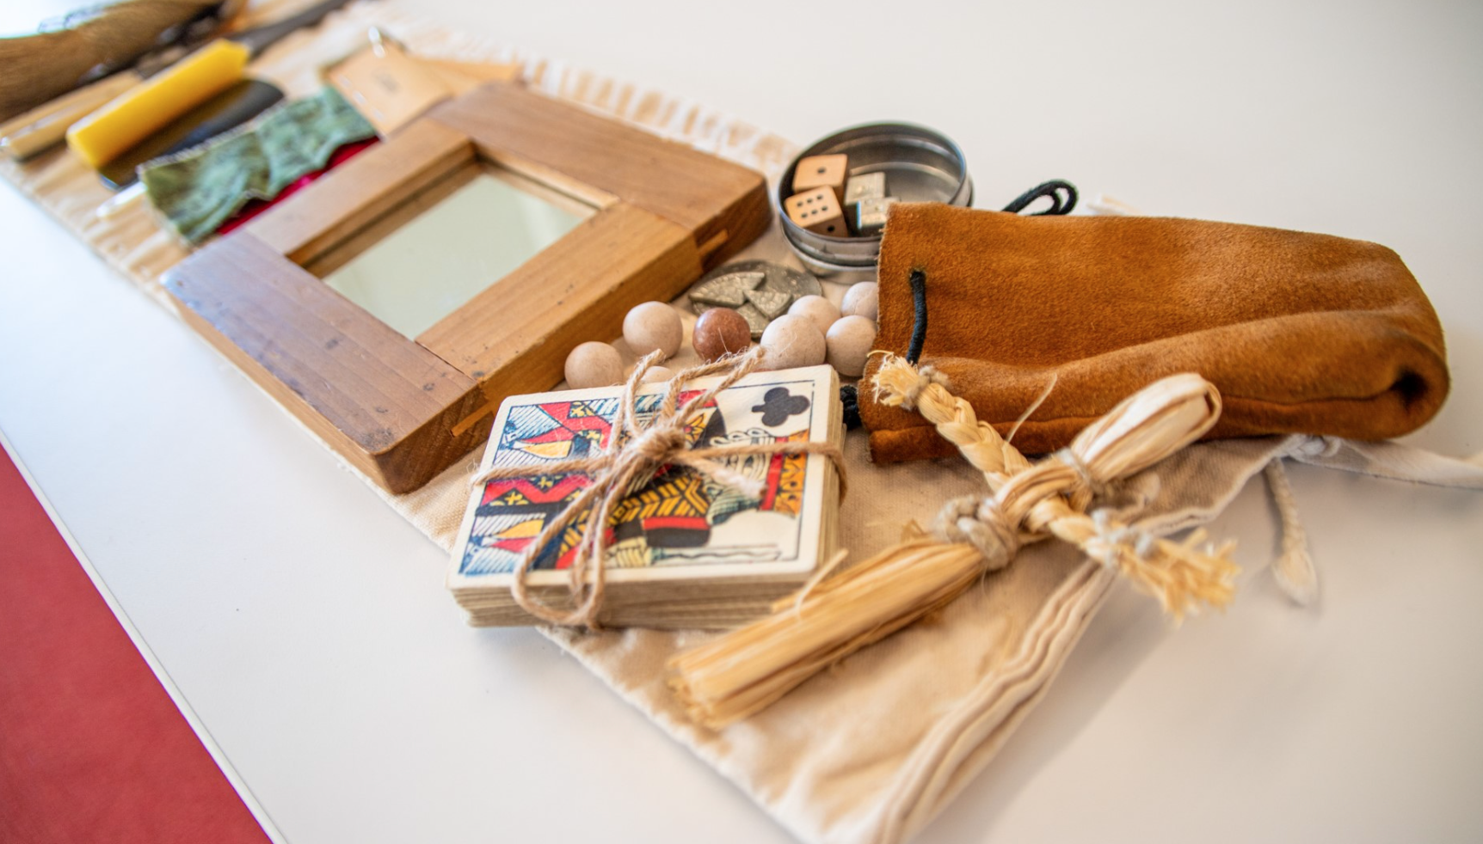
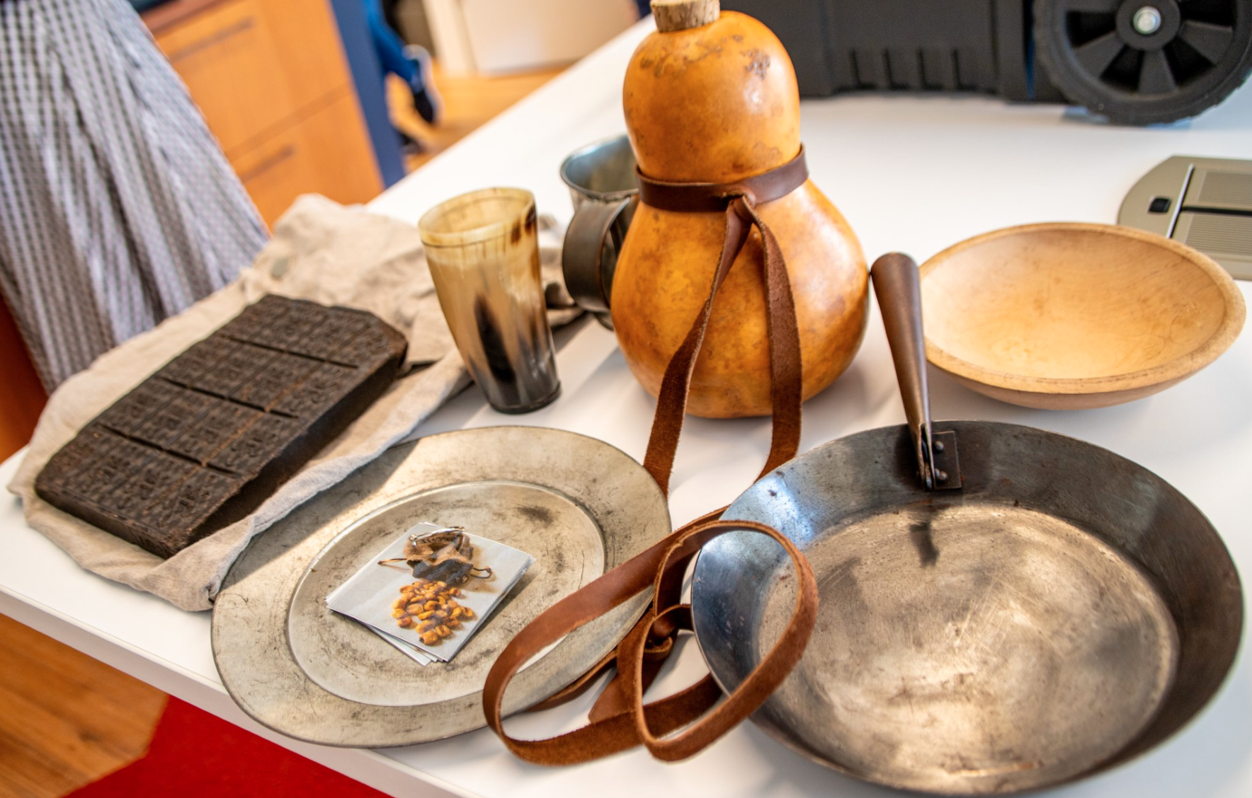
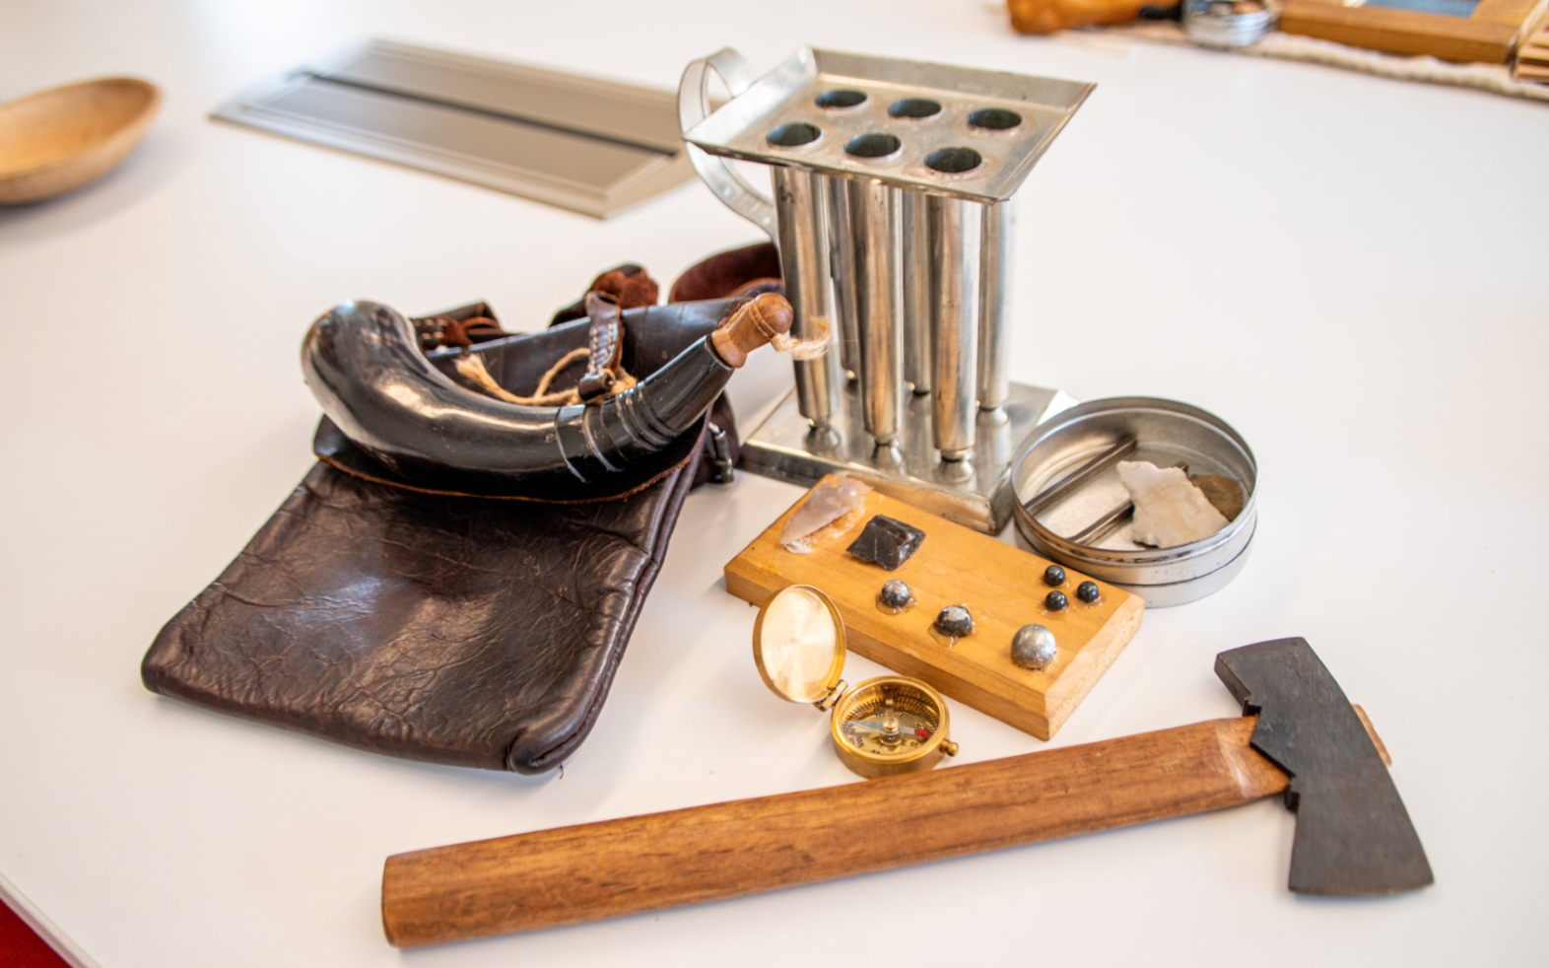
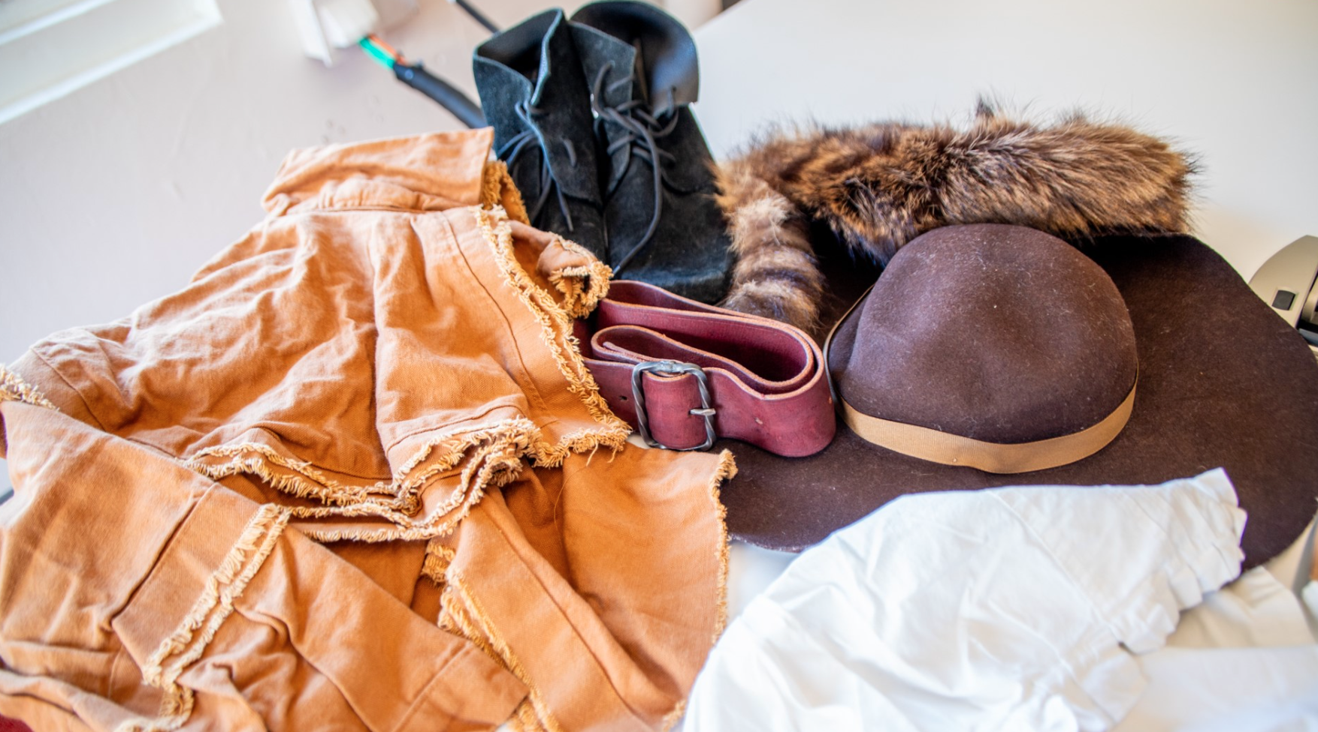
Unpack Texas History
Explore objects from the 1800s in the Alamo History Trunk digital presentation. This resource includes images, descriptions, and primary source references for the reproduction items found in the Alamo History Trunk. The items are organized in four sections: clothing, luxury items, tools and nourishment.
Alamo History Trunks are free to check out for two-week periods to teachers who pick up and return to the Alamo.
Share your feedback or comments with us!
education@thealamo.org

Slide 3
CLOTHING

Slide 4
Finding clothes in early 1800s Texas was not easy. Many of the settlers could afford only a few sets of clothing―and clothing items were handmade. Stephen F. Austin wrote in a letter to his mother and sister in 1824.
“It is my wish that nothing should be worn in the family but homespun, at least for several years it is the cheapest but what is of more importance it will set an example to the rest of the settlers. We are all poor in this country and therefore all on an equality and so long as this continues, we shall all go on. . . harmoniously.., and our industry will soon remedy our poverty if we have the proper economy with it”
(Austin, 1824)
Homespun: made or spun at home.
harmoniously: free from disagreement.

Slide 5
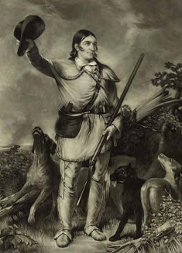
Hunting Frock
A practical, durable piece of clothing, the hunting frock was a popular item of clothing worn by men in frontier Texas. Homemade, they fit loosely and were cinched by a belt. The fringe could be used for repair of other garments (Holman & Parsons, 1979). Many individuals can be seen in their portraits wearing hunting frocks including Stephen F. Austin, Sam Houston and David Crockett.
In his autobiography, when Crockett spoke to a friend in Tennessee about his plans to run for office, he stated that he
“would therefore have me a large buckskin hunting-shirt made” in preparation (Crockett, 1834, p. 89).
Though the hunting frock in the trunk is made of cotton, many would have been made of buckskin.
Durable: able to withstand wear, pressure, or damage
Hunting frock: a fringed coat; also called a hunting shirt
Buckskin: an animal skin from which clothing was made
Print of David Crockett in hunting frock. Stuart, C. (n.d.). Colonel Crockett. Prints
and Photographs Division, Library of Congress, Washington, D.C.].
http://www.loc.gov/pictures/resource/pga/04179/

Slide 6
Fabric Swatches
Fabrics were, like most things in Texas, difficult to come by. According to one Austin’s original settlers (the Old Three Hundred) William DeWees,
“once in a great while we are able to obtain a small piece of unbleached domestic or a bit of calico, at the exorbitant price of seventy-five cents a yard, from someone passing through the country; but this is very seldom." (DeWees, 1854, p. 45).
Furthermore, when Texas was first settled, spinning wheels and looms (used to create fabrics) had to be left behind because, in the words of Noah Smithwick (a participant in the Battle of Gonzales),
“there was, as yet, no use for them―there was nothing to spin” (Smithwick, 1900, p. 16).
Exorbitant: unreasonably high
Seldom: not often or common

Slide 7
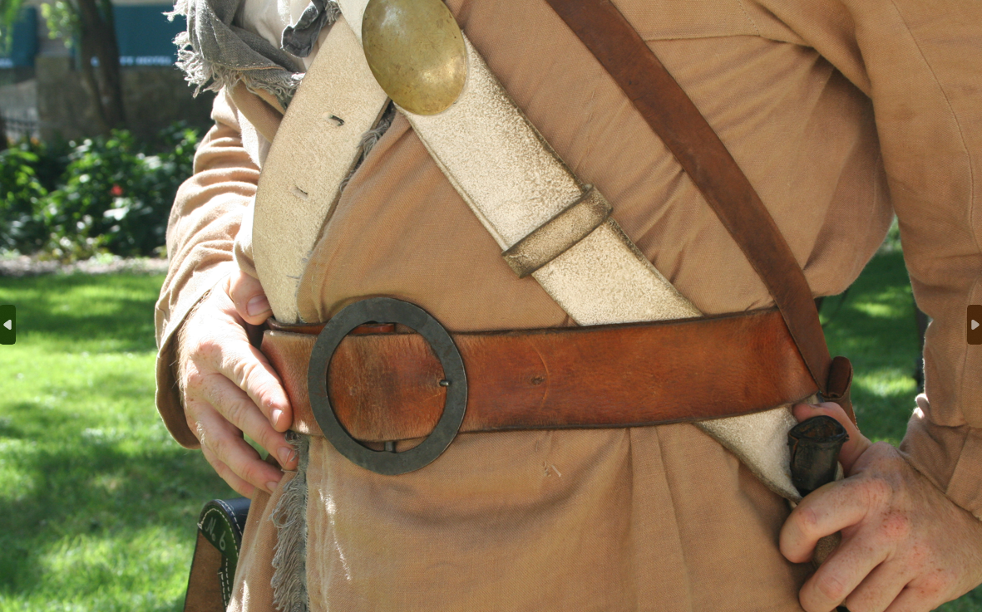
Belt
Most of the clothing in early 1800s Texas was homemade, and the fit was not always ideal. Belts were a simple solution to hold baggy and loose-fitting clothes on the body.
Made of leather and a metal buckle, the belt could also hold pistols, ammunition, and knives
(Holman & Parsons, 1979).

Slide 8
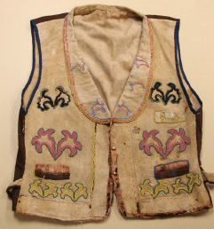
Buckskin
A clothing material that was made from the hides of animals, buckskin is created by cleaning the skin of an animal, scraping and rubbing it to create softness, and smoking it for weather resistance. It was known for its durability and worn by many men of Texas (Holman & Parsons, 1979).
Indigenous communities were also known to trade and give buckskin to settlers. William DeWees wrote of the kindness of the Tonkawa tribe in 1823.
“Were it not for the Toncoway Indians, a small tribe who are friendly to us and supply us with dressed deer skins, we should be almost entirely destitute of clothing” (DeWees, 1854, p. 44-45).
Hides: the skin of an animal
Destitute: without the basic life necessitites

Slide 9
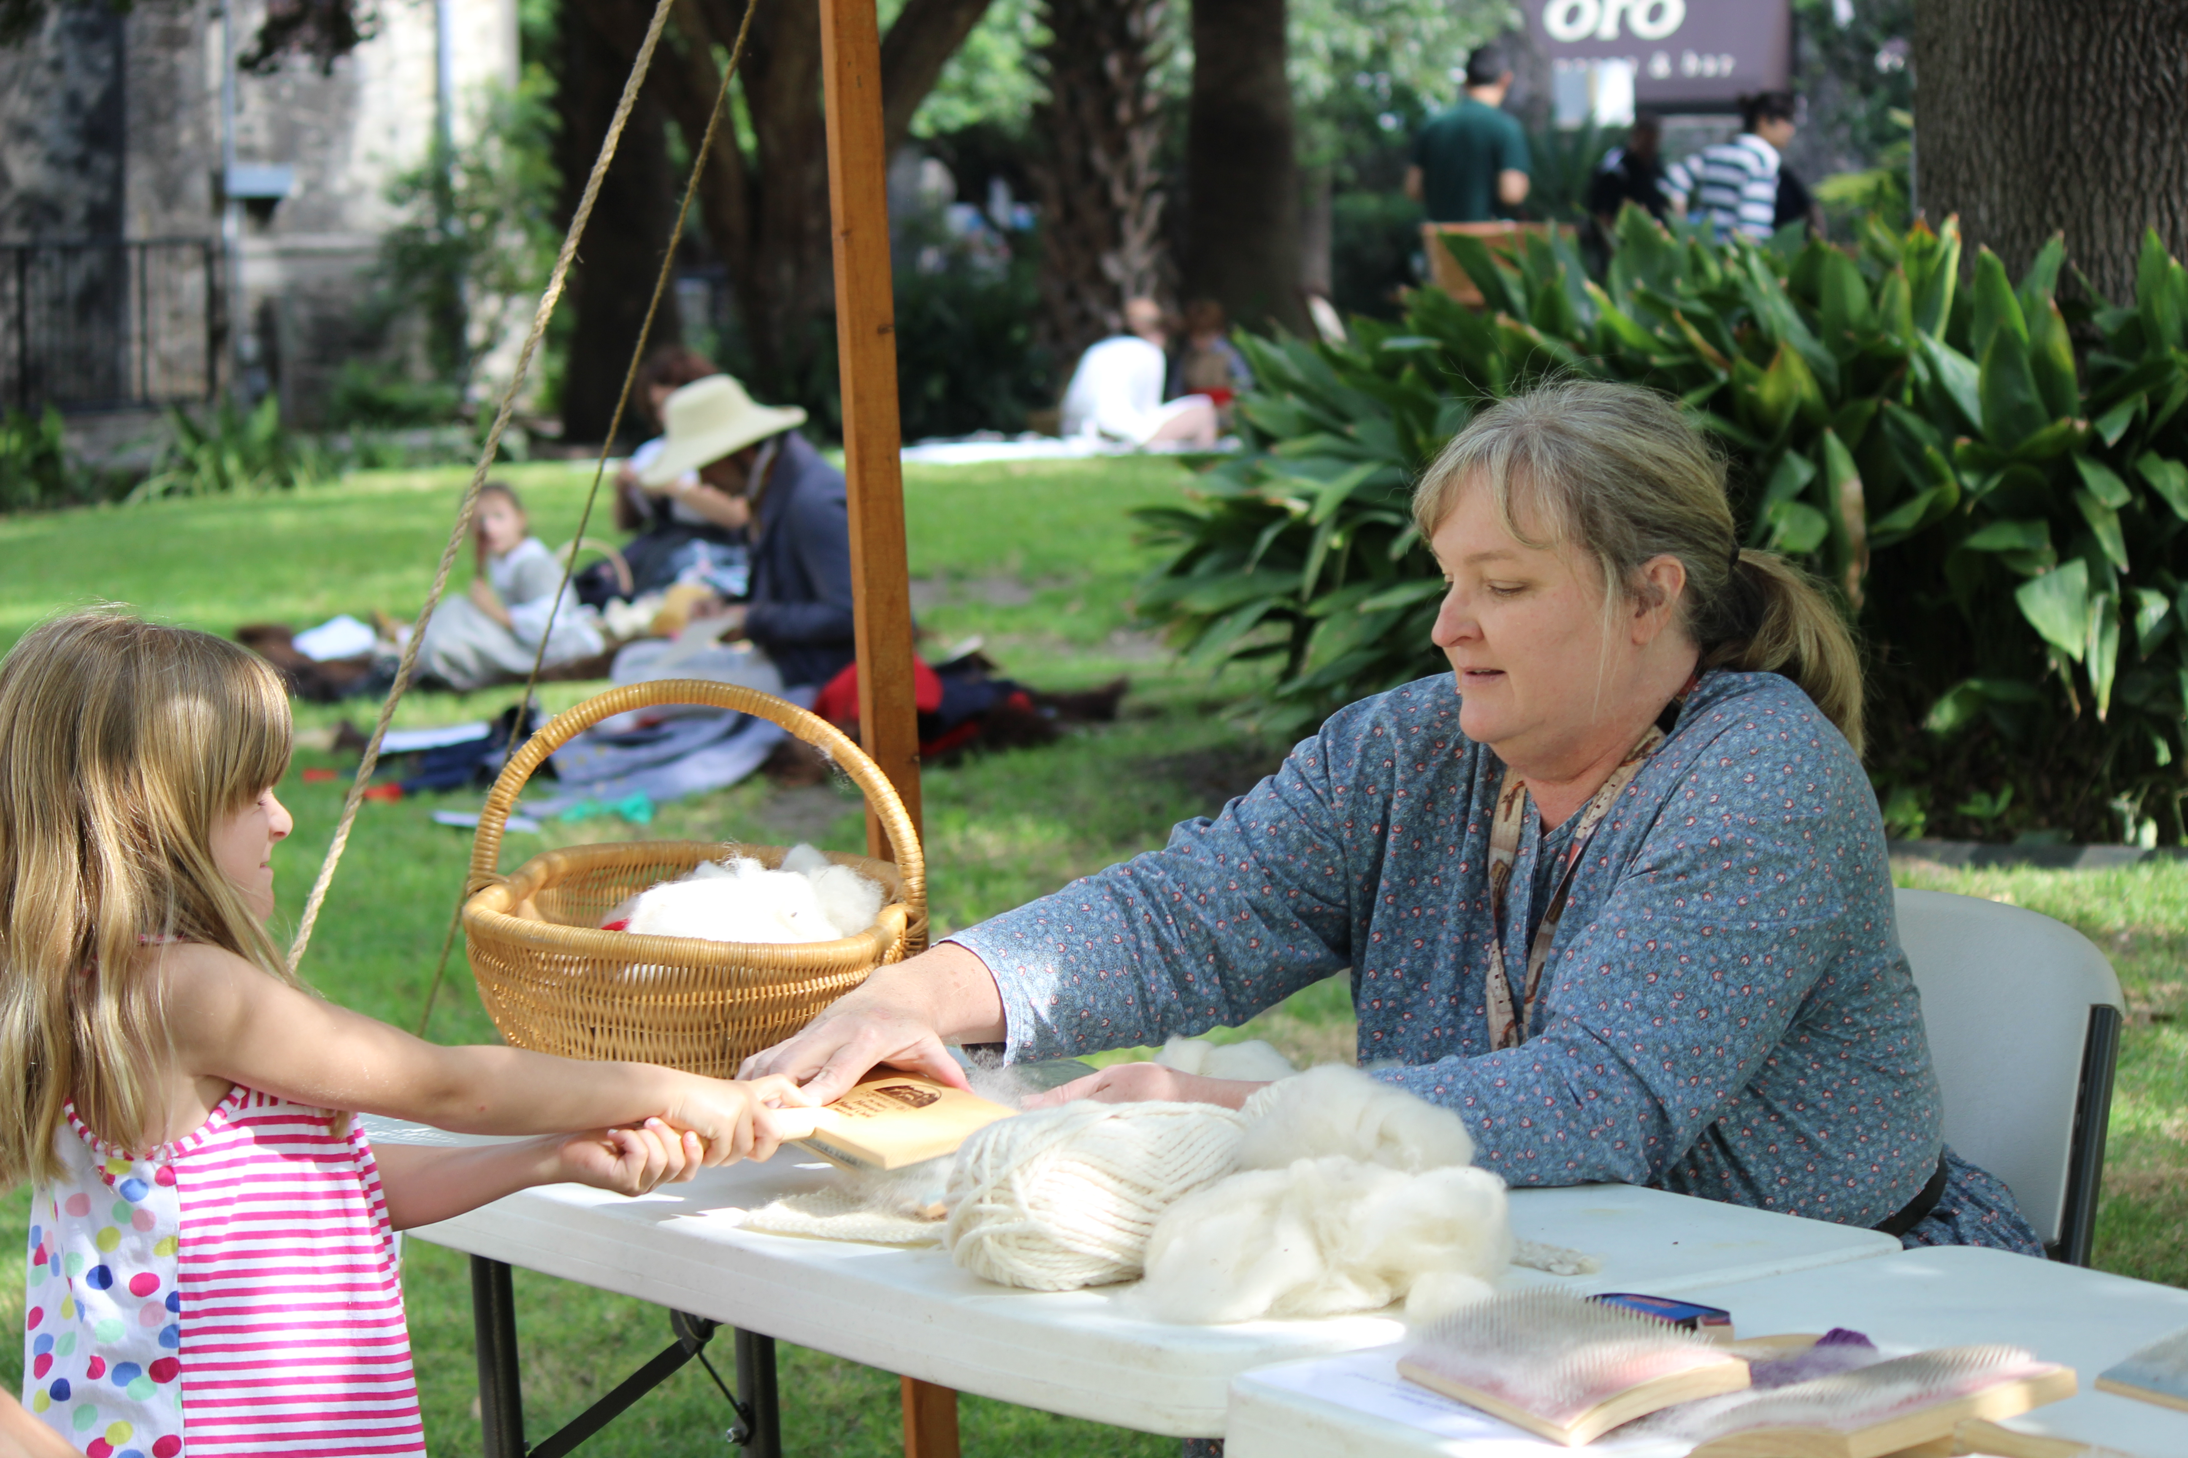
Cotton
Though buckskin was widely available, fabrics were cooler, easier to sew, and softer on the skin. The cotton plant was grown in Texas by Spanish missionaries in the 1700s because it grew well in the hot climate (Holman & Parsons, 1979).
A cotton ball is a fiber that serves as a fluffy protection growing around the seeds of the plant. When harvested, the fiber was cleaned, spun, and woven to create fabric.
A 1772 inventory of Mission San Antonio de Valero, now known as the Alamo stated that the mission housed a workshop which contained scales for weighing cotton, 24 arrobas (Spanish weight measurement equal to 32 pounds), and a chest of 12 pounds of cotton thread (Barón de Ripperdá, 1977, p. 34).

Slide 10
Denim
Denim was cotton fabric woven into a tough, twill weave (which creates a diagonal pattern). The fabric was used for work clothing that could handle harsh conditions. (Holman & Parsons, 1979).

Slide 11
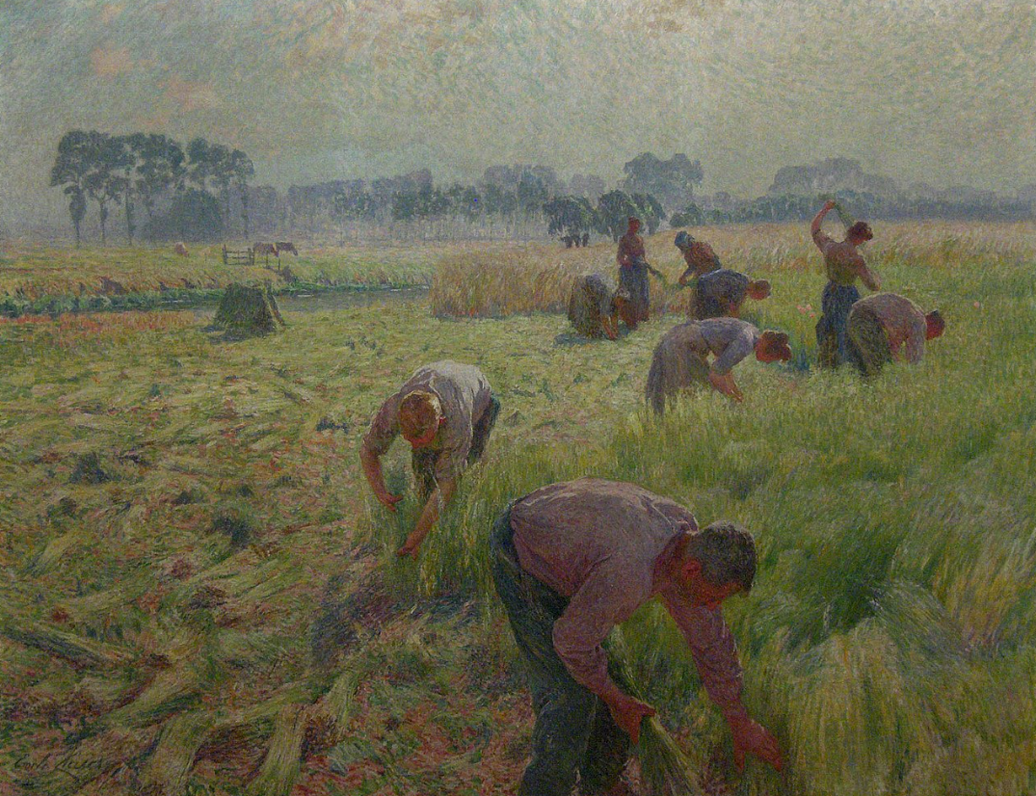
Linen
Linen comes from a flax plant. Linen lost its popularity after the invention of the cotton gin because cotton was softer.

Slide 12
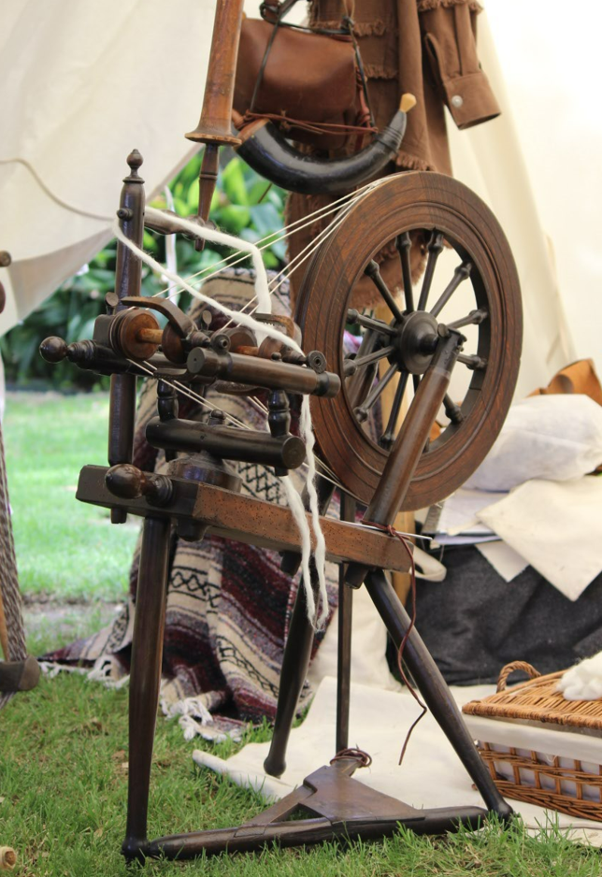
Wool
Wool was made into fabric like cotton and linen. The fibers were taken from the hair of sheep rather than a plant. A spinning wheel was used to turn fibers into thread or yarn, and a loom was used to weave the thread into fabric.
Soldiers at the Battle of the Alamo wore clothes made from different fabrics, but the only known uniform was worn by the New Orleans Greys. Typical winter military uniforms of the period were made of wool. This would have kept them warm in the bitter 1836 Texas winter, and the fire-resistant material made it safer for them to work the cannons.
Weave: A way of making fabric by interlacing long threads passing in one direction with others

Slide 13
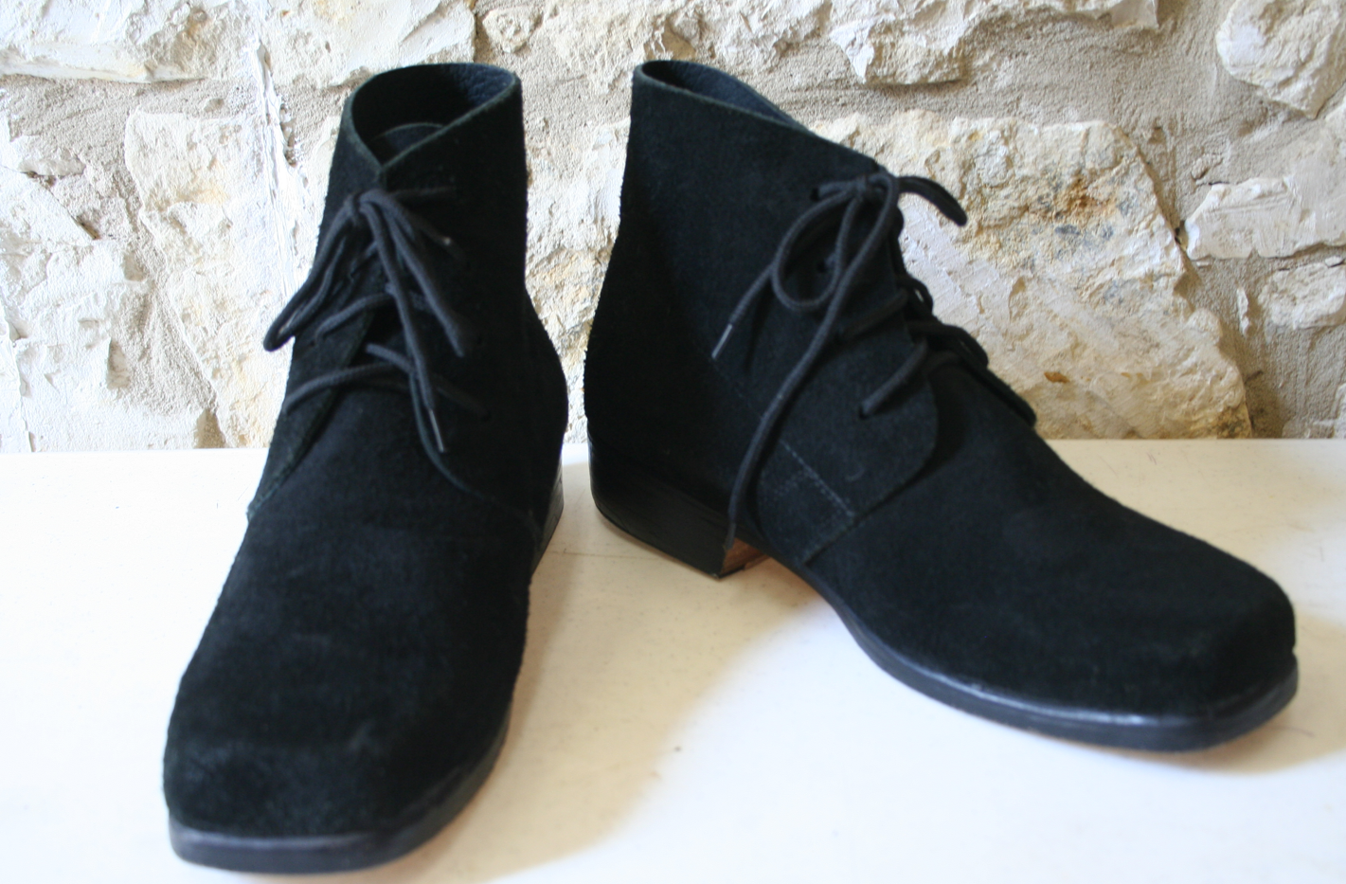
Brogans
Randolph B. Marcy, a U.S. Army Captain, spent considerable time in Texas and the Southwest. He wrote
“in the summer season shoes are much better for footmen than boots, as they are lighter, and do not cramp the ankles” (Marcy, 1993, p. 39)
Boots were expensive and not always available, so a simple footwear called brogans was worn instead. The price ranged wildly, and Charles Pressler, a German immigrant, wrote to his family in 1847 that,
“shoes and boots are in high price. I advise you to provide yourself with those” (Holman, 1874, p. 30).

Slide 14
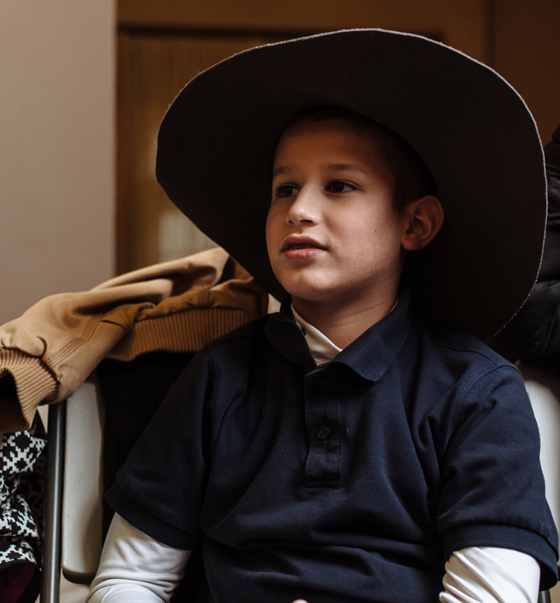
Slouch Hat
Slouch hats were used throughout Texas and other parts of Mexico. As explained in a letter from James Austin to his brother Stephen in 1823, slouch hats were used.
“Do not forget to bring me… a Spanish wide brim, white, wool hat. I understand they are very cheap, and it will be almost impossible to stand the prairie without one." (Baker, 1924, p. 649).
It was a common hat that could be shaped by the wearer. The hat's quality was determined by its ability to hold its shape (Holman & Parsons, 1979).
Brim: the outer edge at the bottom of a hat

Slide 15
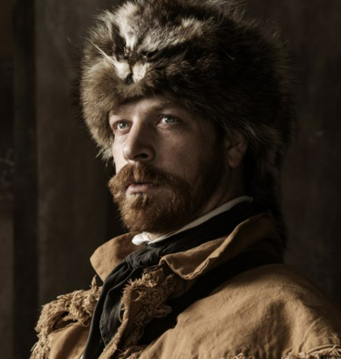
Fur Hat
Fur hats were made to fit tightly to the head which kept them from blowing off in high winds, and they kept heads warmer in cold weather. A fur hat could also provide natural camouflage.
Noah Smithwick noted in his memoirs that many hats were present on the 1835 march to San Antonio de Bexar after the Battle of Gonzales, including
“a coonskin cap, with the tail hanging down behind, as all well regulated tails should do” (Smithwick, 1900, p. 110).
Though traditionally hats would have a tail, other variations included antlers, fox ears, and raccoon heads (Holman & Parsons, 1979).

Slide 16
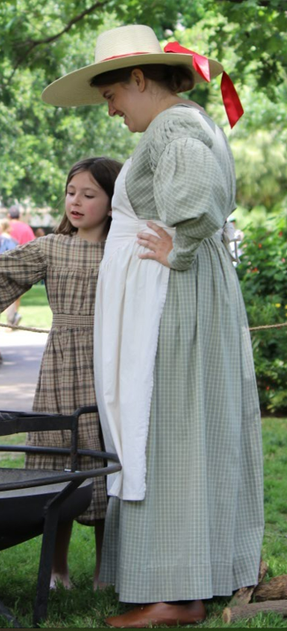
Apron
This style of cotton apron would have tied around the waist with the top portion pinned to a woman’s dress. An apron protected hard-to-replace dresses from damage and provided pockets for gathering eggs, vegetables, and other items that needed to be carried. A colorful use for an apron in 1870 is recorded by James Newberry recalling one of the many skirmishes between an Indigenous community and settlers.
“During the fight Mr. Millsap ran out of cartridges for his Winchester rifle and his daughter, Miss Donnie Millsap, took some in her apron and carried them back to her father; as she was going back to the house the Indians began to shoot at her and as she went through the door of the house, they shot an arrow through her apron and it stuck in the door facing” (Goodnight, Dubbs, & Hart, 1909, p. 215).

Slide 17
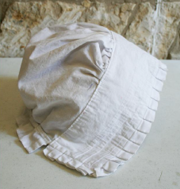
Bonnet
Bonnets were a common head covering for women and offered protection from the hot Texas sun. There were different styles of bonnets, including the cotton bonnet. The strings could be tied under the chin or left loose. Women also wore hats or pieces of fabric to protect their heads, necks, and faces.
Dilue Rose Harris, an 11-year-old girl and her family fled in the Runaway Scrape, shares her story as she remembered returning home after the victory at San Jacinto.
“Father said if he got his cotton to market I should have two or three sun-bonnets, as he was tired of seeing me wearing a table-cloth around my head” (Harris, 1901).

Slide 18
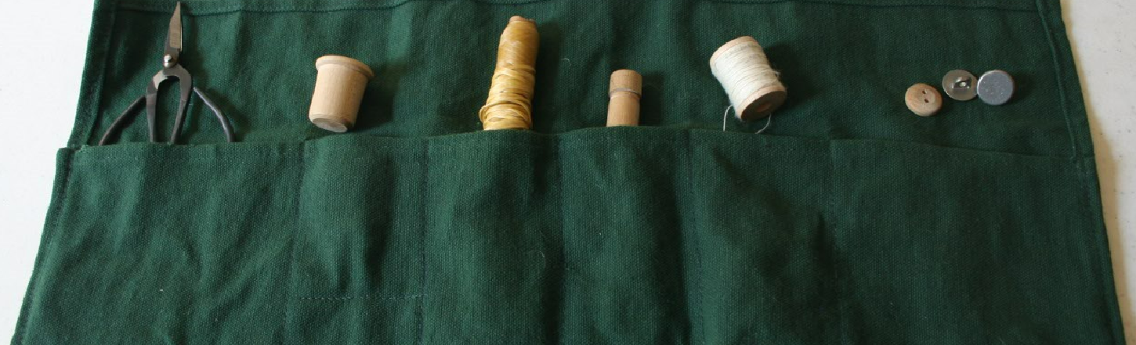
The sewing kit is one of the item recommended for a three-month journey in Randolph Marcy's handbook (Marcy, 1993, p. 39). Clothing was limited, and it was necessary to repair the clothing that pioneers already owned.
Sewing kits were not only used by women―Marcy, in fact, recommends the sewing kit for men. When traveling or on military campaign, men repaired their own clothing . Sewing kits were compact and easily carried with their other gear.
Sewing Kit

Slide 19
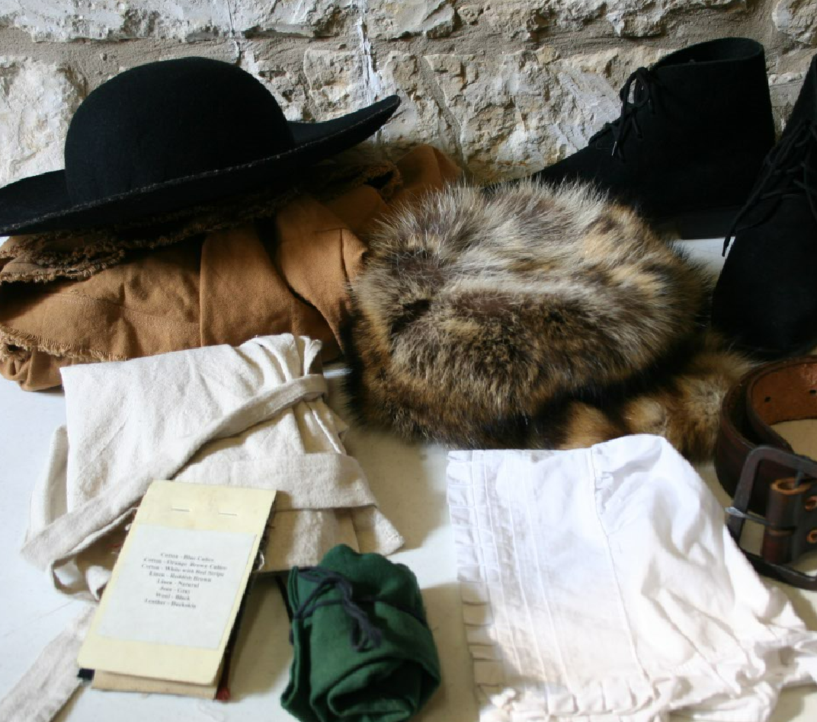
Clothing Questions
Sort the objects into summer and winter categories. Explain your reasoning.
Which object would be considered the most important on the frontier?
How does 1800s clothing compare to what we wear today?

Slide 20
NOURISHMENT

Slide 21
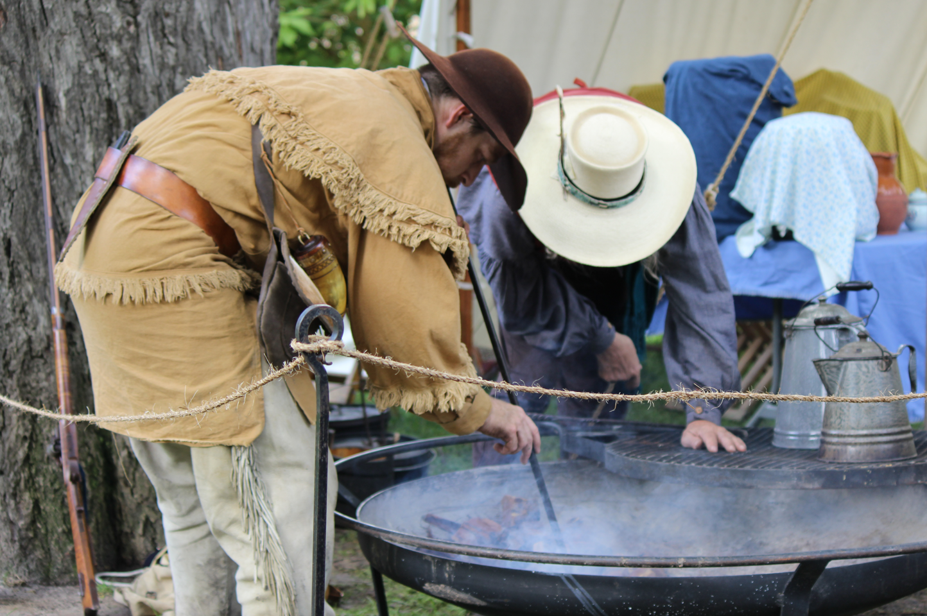
On any frontier, not just in early 1800s Texas, the primary food sources were game and native plants. Agriculture, or the cultivation of crops and animals was not yet practiced at this time.
Even in 1835, they did not have a huge variety of food. A Guide to Texas Emigrants by the Galveston Bay and Texas Land Company stated in 1835 that:
“The hospitality of all is most meritorious, and the usual price of each meal (which consists almost invariably of pork, eggs, bacon, butter, maize cakes, hot coffee, and sometimes venison and other meats), is only one shilling” (Woodman 1835, p. 94).
Hospitality: a friendly and generous reception
Meritorious: deserving reward or praise
Shilling: a former British coin

Slide 22
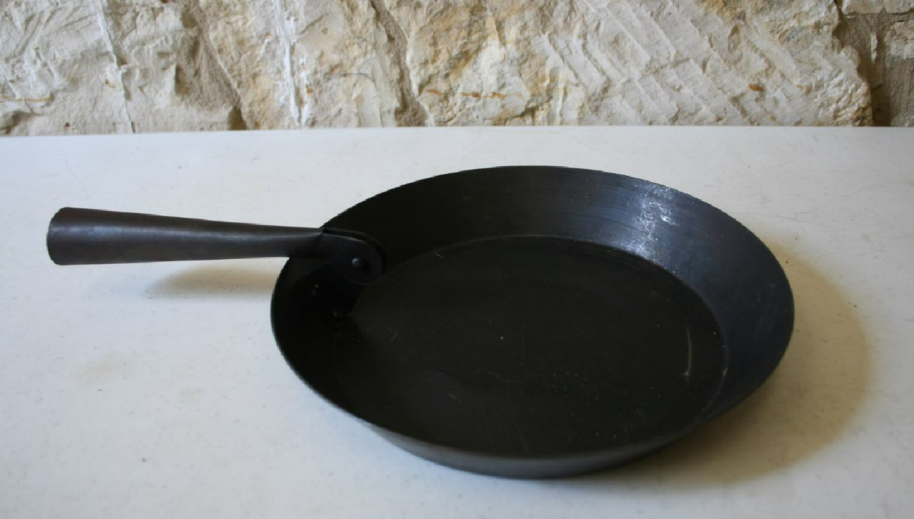
Skillet
Whether at home or on the trail, if Texans wanted to cook their food, a skillet or frying pan was used. An inventory list of supplies at the Alamo dated February 3, 1836, included for frying. (Chariton, 1990, p. 208).
This skillet is made of sturdy iron with a handle that can be folded for easy transportation. It is very similar to the:
“frying and baking pans of wrought iron” listed as necessary for traveling groups of six to eight people (Marcy, 1993, p. 40).
Wrought: metal being shaped by hammering

Slide 23
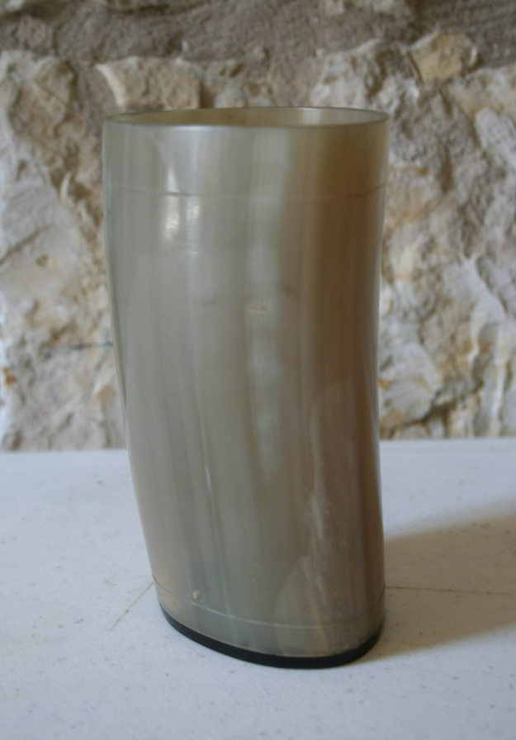
Horn Spoon & Cup
Pioneers were resourceful and used all parts of animals harvested for meat. Softened by boiling, horn could be placed into molds to form cups, spoons, and other useful items.
However, horn could be a fragile material and break easily. Likewise, if the horn got too hot, it would lose its shape.

Slide 24
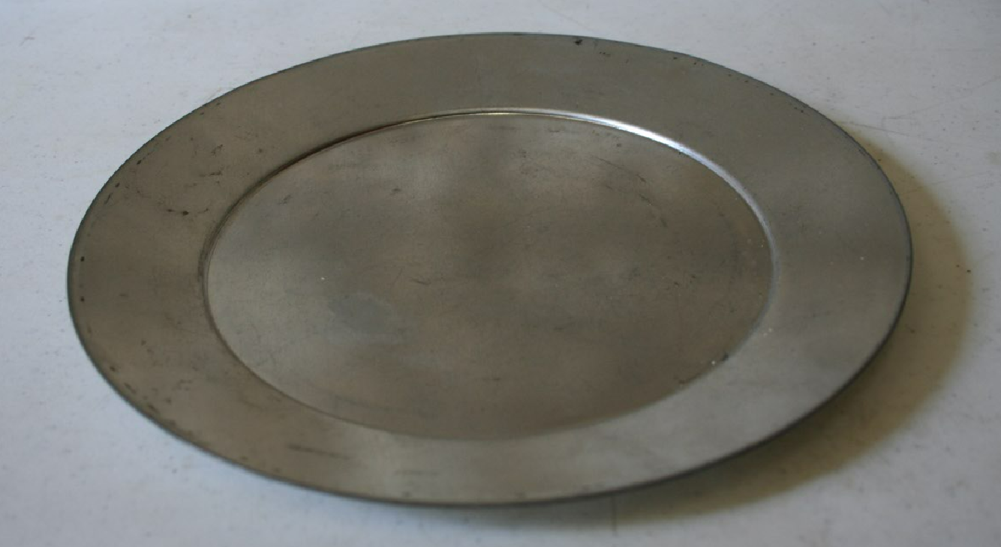
Tin Plate & Cup
Tinware or sheet iron coated with a thin layer of molten tin, was lightweight and sturdy. In comparison to horn and stoneware, tin cups could be used as boilers for making coffee, tea, soup, or stew.
Mugs made from pewter were also in use but were going out of fashion. Randolph Marcy recommended:
“cups of heavy tin, with the handles riveted on [and] tin plates” for camp equipment (Marcy, 1993, p. 40).
Molten: liquefied by heat
Riveted: joined with a permanent fastener

Slide 25
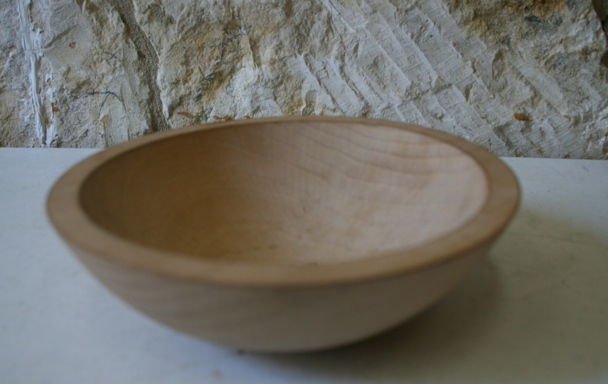
Wooden Bowl
Dishes for travel were made of studier materials than ones made for the home.
The 1836 Guide to Texas Emigrants recommends a wooden bowl for mixing as one of the cooking tools to be taken to Texas (Woodman, 1835, p. 188). Though Randolph Marcy was quick to point out that he would use tin for anything requiring water since wood is,
“liable to shrink and fall to pieces” (Marcy, 1993, p.40)
Tin was not always available, and creating a wooden implement required only wood and a carving tool. Bowls were also used as drinking vessels.
Liable: likely to do something

Slide 26
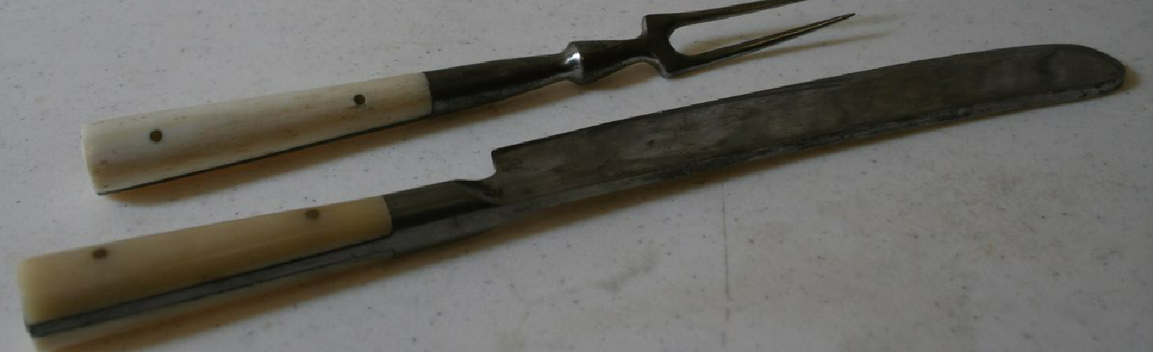
Eating utensils were made from wood, iron, horn, pewter, and silver. Handles were sometimes covered in wood, horn, or bone. Though perhaps not a necessity like the skillet, forks and knives were recommended by Randolph Marcy (Marcy, 1993, p. 40) and they were carried by those on the Santa Fe Expedition. Marcy’s description grass fire illustrates a drawback of using iron materials.
“Two of our wagons only had been entirely consumed, but nearly all had suffered… Our pots, pans and kettles, knives and forks, were converted into old iron―everything was gone” (Kendall, 2004, p. 96).
Eating Utensils

Slide 27
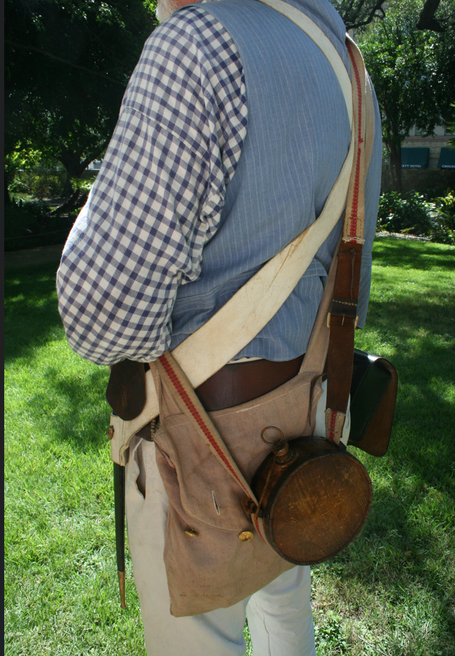
Haversack
A haversack is a cloth bag with a strap that is used to carry personal items and food.
During the Mexican War, the American Flag newspaper (produced in United States occupied Matamoros, Mexico) stated on May 19, 1846 that,
“every man of the divisions will take two days’ sustenance in his haversack. This will be the general rule for all marches when a greater number of rations is not specifically mentioned” (Headquarters of the Army, 1847, p.2).
The recommendation was useful and similar cloth bags were used by civilians as well.
Sustenance: food or drink as a source of strength
Rations: a certain amount during a shortage

Slide 28
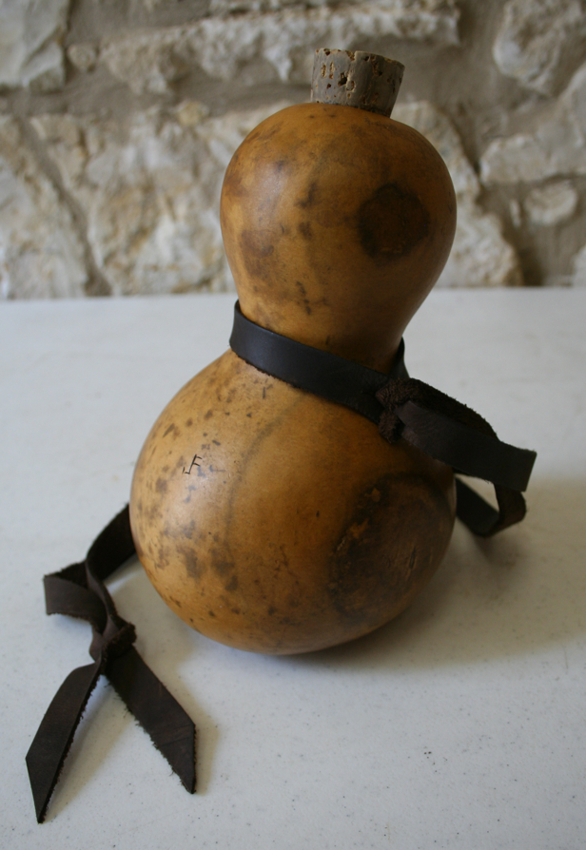
Gourd Canteen
The Spanish Missions of San Antonio de Béxar (including the Alamo) were purposefully settled along the San Antonio River. Water from the river was used for drinking as well as watering crops and animals through an irrigation system called an acequia (irrigation ditch).
Although there were many types of canteens during this period, a gourd canteen was made from a variety of squash that could be dried, deseeded, and made into a watertight container. Gourds with long stems could also be made into ladles such as a “dipping gourd.”
Irrigation: the supply of water to land or crops to help growth, typically by channels
Ladle: A large long-handled spoon with a cup-shaped bowl

Slide 29
FOOD

Slide 30
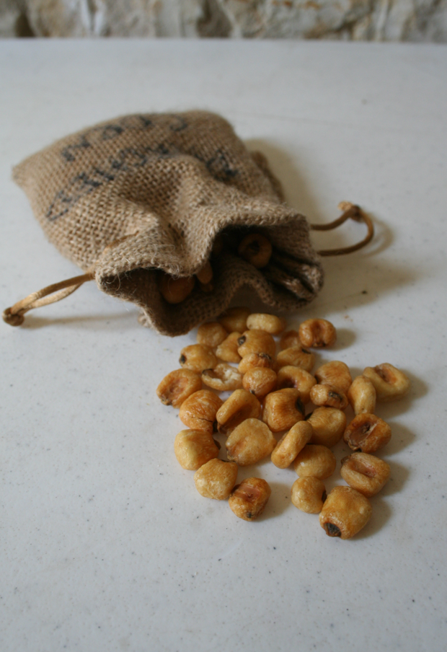
Parched Corn
Corn was by far the most important grain in pre-industrial America. It was used as food for people as well as livestock.
At the siege and battle of the Alamo, it was eaten by soldiers at the former mission. William B. Travis, commander of the Alamo, wrote of corn in his famous letter on February 24, 1836:
“When the enemy appeared in sight, we had not three bushels of corn―we have since found in deserted housed 80 or 90 bushels (Travis, 1836, p. 2)
Bushels: A unit of volume equal to eight gallons

Slide 31
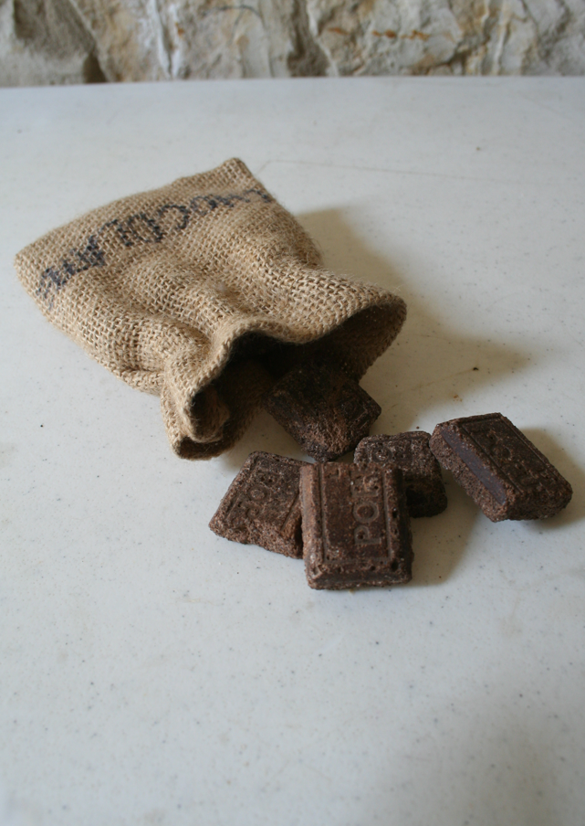
Chocolate
As the cacao tree originated in what would become Mexico, it made sense that chocolate would be found in Mexican Texas. However, the chocolate used by early Texans would have been very different than the chocolate we eat today. In fact, it wasn’t originally eaten. Chocolate began as a bitter, unsweetened drink.
The Europeans brought sweetness to the drink, but it wasn’t until the late 1840s that chocolatiers made sweetened chocolate to eat.

Slide 32
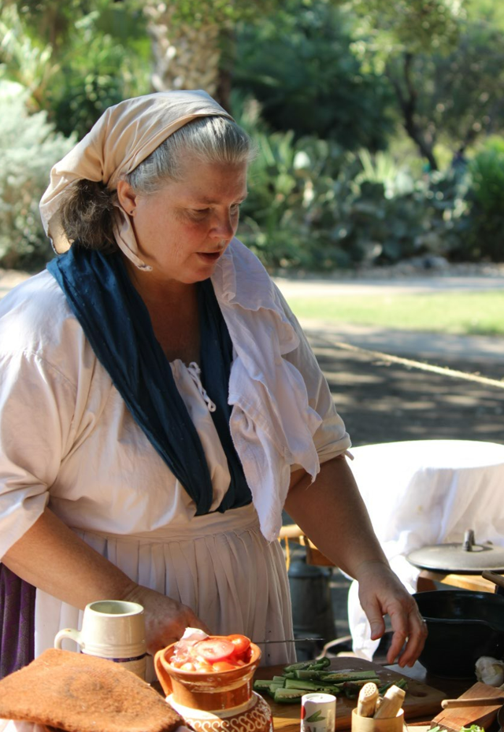
On the frontier, some food staples were limited as recorded by Irish settler, Jemima Toll in a letter to a friend who would soon join her in Texas:
“Bring a supply of sugar, coffee, tea and flour for 8 or 9 months; if you have any to spare, you get your price” (Woodman, 1935, p. 169).
Anything that couldn’t be grown or raised in Texas depended on shipping from other locations such as New Orleans. Dilue Harris recounts this very challenge in February 1834,
"The schooner didn’t come to Harrisburg in the fall; so there was no flour, coffee, bacon, nor lard in the country” (Harris 1, p. 96).
Staple: A basic food source that make up a significant portion of a person’s diet
Schooner: A sailing ship

Slide 33
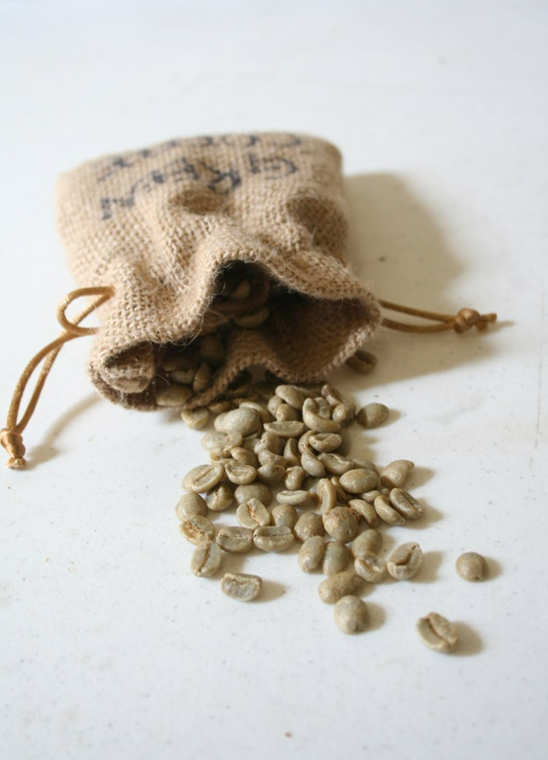
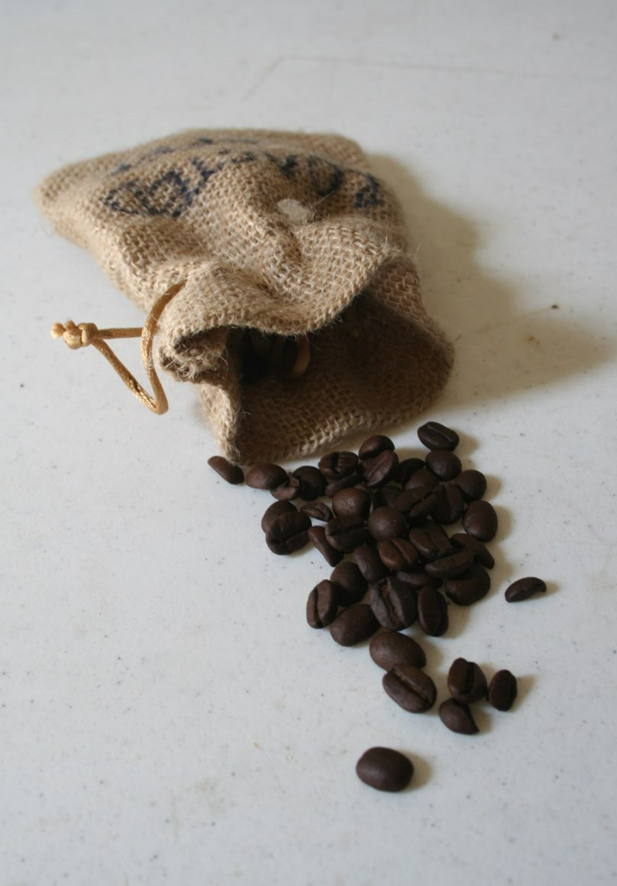
Coffee- (Roasted & Green)
Coffee was purchased as raw beans. These were roasted in a pan or cup over a fire, beat or ground into small pieces, and then boiled in water. It was a common drink to be found throughout Texas. It was even present during the battle of the Alamo. There were 2 bags of coffee recorded in the stores of the Alamo on February 3, 1836, but two bags for almost 200 people did not last long.
Alamo defender Isaac Milsaps wrote to his wife on March 3rd
“we have beef and corn to eat but no coffee, bag I had fell off on the way here so it was spilt” (Chariton, 1990, p. 303).
Though some settlers developed the coffee drinking habit in the United States before they immigrated to Texas, coffee was a common drink in Mexico as well.

Slide 34
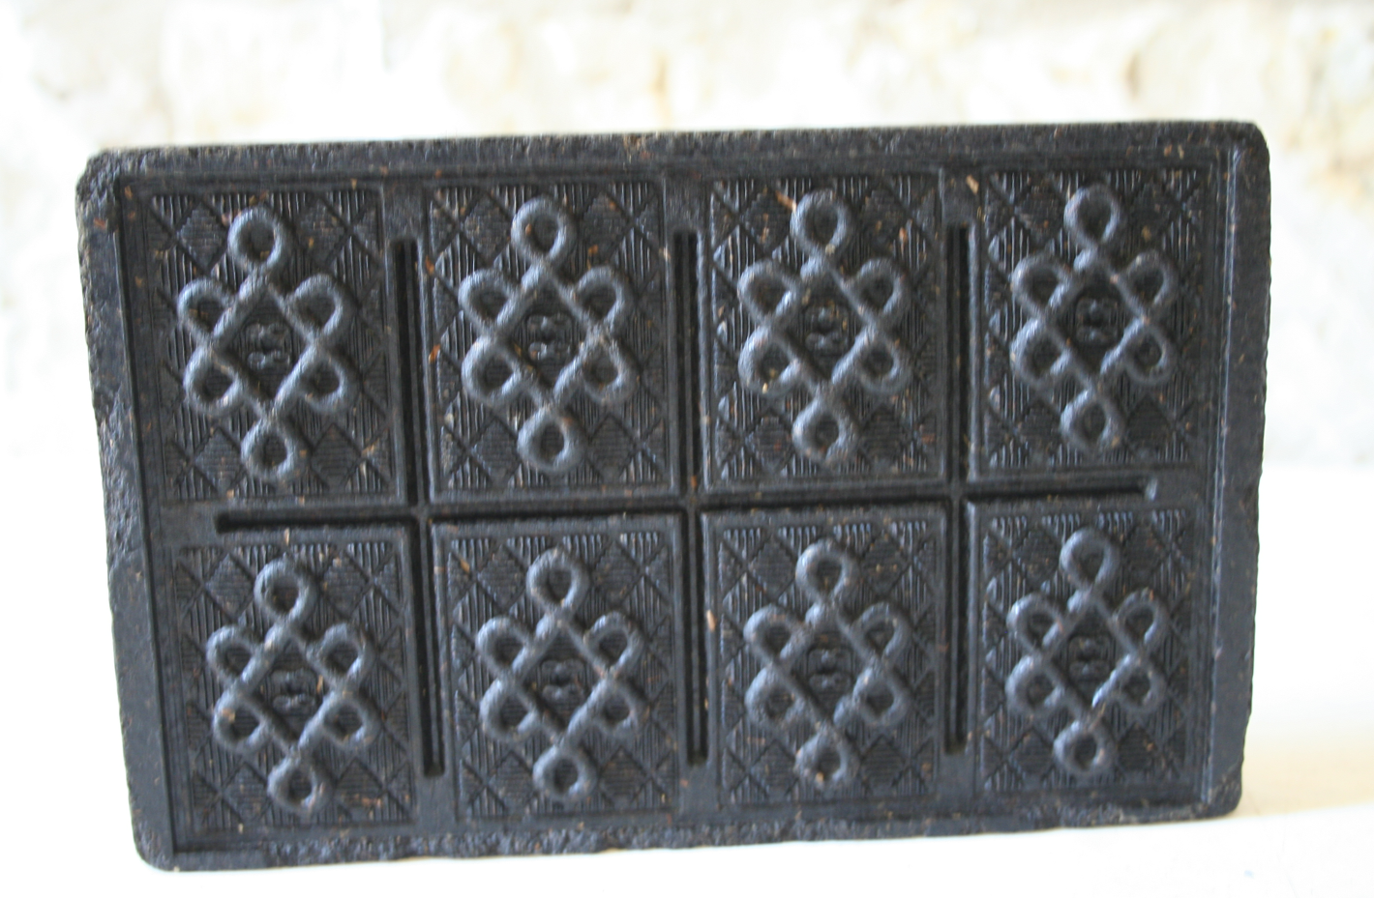
Brick Tea
Tea was often brought over from China in “bricks” of compressed, dried leaves. The bricks made it possible for tea to travel without spoiling. This was difficult to accomplish with fresh tea leaves. The bricks could be scraped with a knife and the flakes boiled.
A shortage of tea in 1834 Texas is recounted in Dilue Harris' account of their mother:"Mother had “rice, tea, dried apples and white sugar which she had brought from New Orleans, and which she was keeping for hard times and sickness"(Harris, 1900, p. 96)

Slide 35
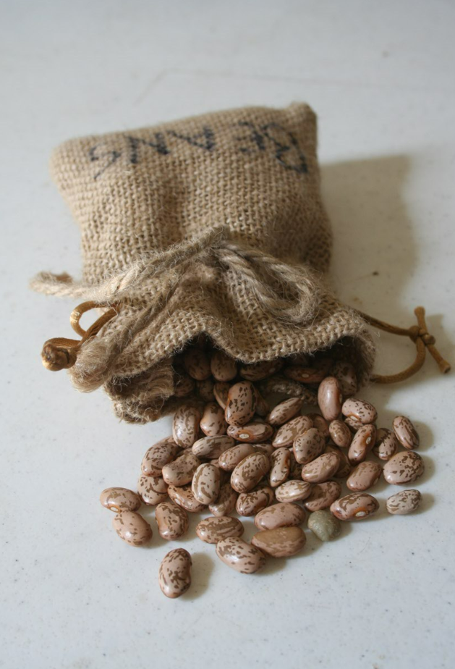
Dried Beans
On the trail, travelers carried dried beans because they would not spoil. When Stephen F. Austin wrote to his family in 1824 before they traveled to Texas he recommended,
“the furniture and other heavy articles. . . sell for pork, flour, beans etc. to use on the road for you must start with enough provisions enough to last the whole journey.” He also recommended many items to bring in excess as they would sell very well including "from Missouri several barrels of beans (Baker, 1924, p. 785–787).
Provisions: food supplies

Slide 36
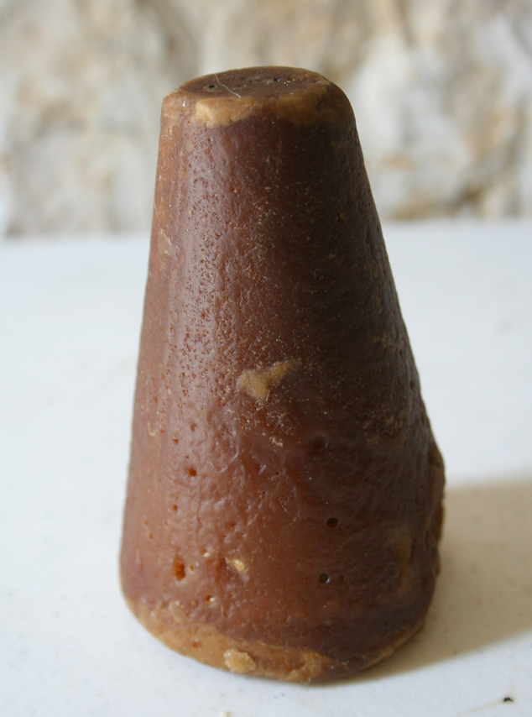
Piloncillo
The sugar available to Texans came from sugarcane and was dark in color. Sugar was molded into a shape called a sugar cone. In Mexico these were called piloncillos.
An 1821 report shows how difficult it was to plant sugarcane crops.
“. . .scarcely leaving the people the necessary time for the cultivation of the lands previously granted them." However one of the few crops they had been able to plant was sugar cane. This sugar led to "the only article manufactured in the province... the "Piloncillo' sugar" (Martinez & Flores, 1856, p. 1).
Scarcely: hardly or very little
Cultivation: to prepare land for growth of crops
Province: an area of land that is part of a country

Slide 37
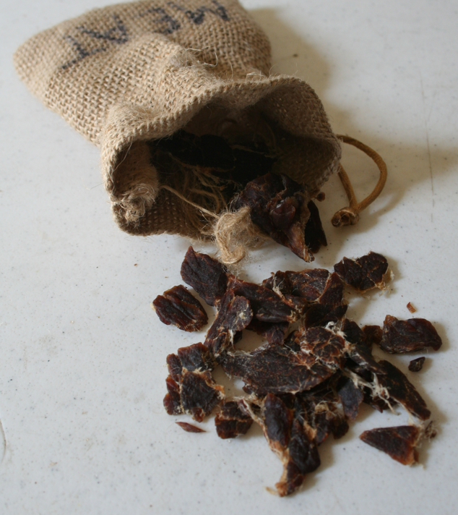
Dried Meat
Though Texas has become known as cattle country, pigs were the more common meat item simply because the animals required less care. Meat from freshly butchered animals had to be eaten quickly or it would spoil, and Texas settlers could not afford to waste food. When a group of travelers stopped at the house of Dilue Harris in 1834, this is the method they used to preserve their meat.
"He had a large scaffold built over a trench and made a fire under it. He butchered the beeves (beef) and dried the meat over the fire" (Harris, 1900, p. 99).
Another preservation technique was to place the meat in a "salt box" where salt soaked into the meat to keep it from spoiling.
"increase[ed] in weight 150-fold in the first eight months of life. Another significant factor in the popularity of pork was its 'good keeping qualities" (Murry, 1991, p. 93).

Slide 38
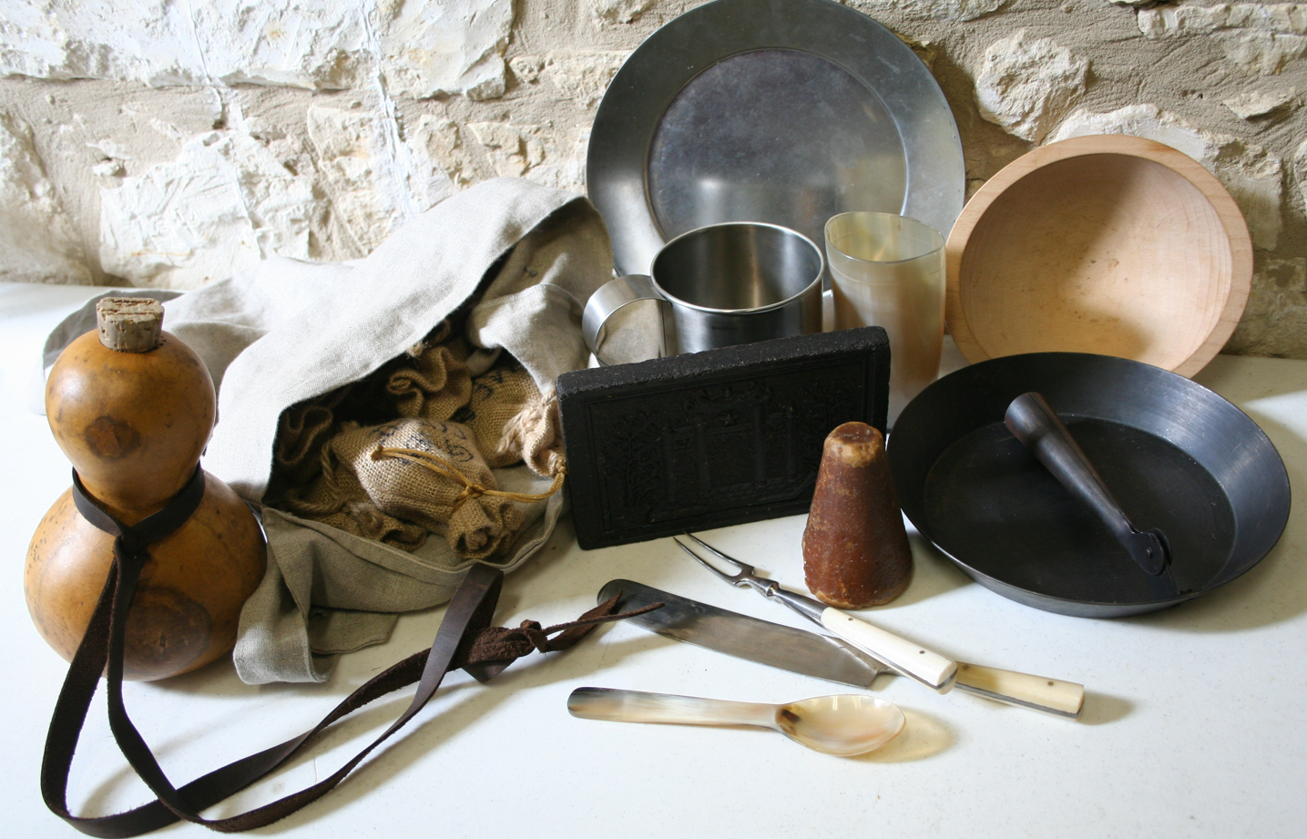
Nourishment Questions
If you had to choose one food item to have on the frontier, which would you pick? Explain.
If you were on the frontier and needed to leave a few objects behind. Which nourishment objects would you leave? Why?
Do you think all individuals carried these objects? Explain.

Slide 39
TOOLS

Slide 40
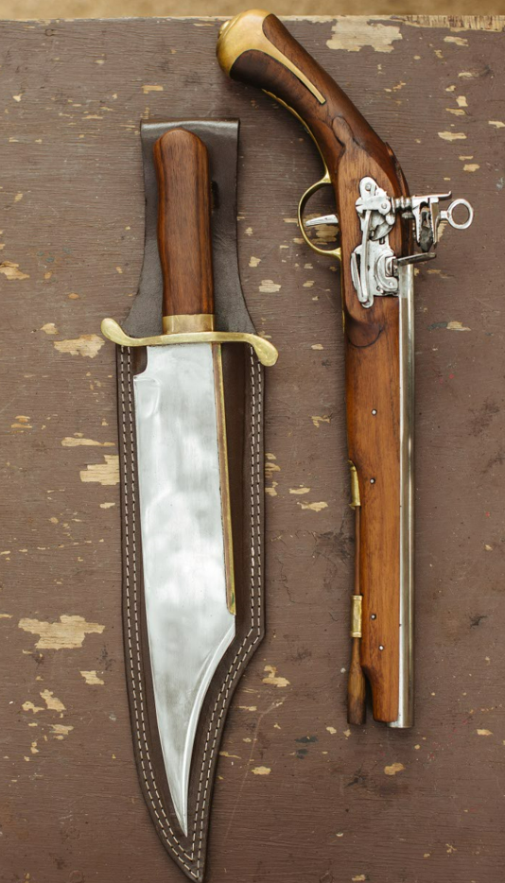
Although it was important to take care of clothing and food, Texans would not be prepared on the frontier without certain tools.
In preparation for the Santa Fe Expedition in 1841, George Kendall wrote of these much-needed supplies:
“My rifle―short, but heavy barreled, and throwing a ball, with great strength and precision, a long distance… My pistols, powder and lead, bowie and other knives, blankets, accoutrements for my horse, and other implements and articles necessary for a prairie tour” (Kendall, 2004, p. 6).
Tools also helped provide protection from the harsh environment. However, just having tools was not enough―hunting, fire starting, and building shelters were required skills. Those who came to Texas unprepared soon learned why the land had long remained unsettled.
Accoutrements: additional items of dress or equipment

Slide 41
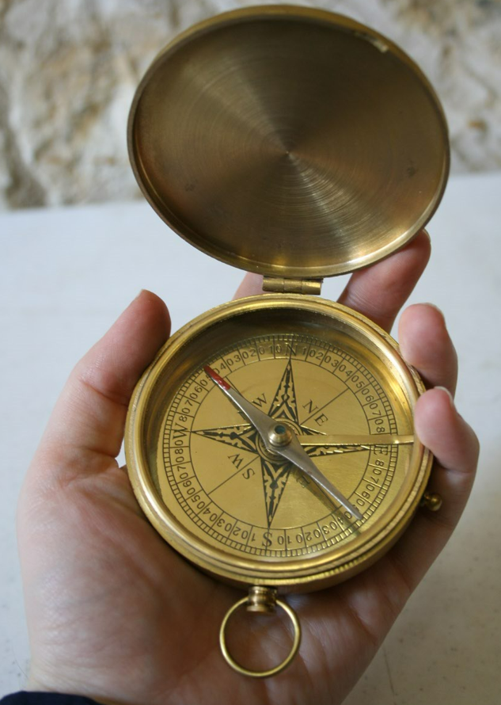
Compass
Getting lost could be a dangerous experience. Staying too far from civilization and known paths left Texians open to the many hazards.
For indigenous groups familiar with their land, the compass was an odd tool. Randolph Marcy wrote of his attempt to show the tool to a member of the Delaware tribe.
“He seemed very much interested in its mechanism, and very attentively observed the oscillations of the needle. . . He did not, however seem to comprehend it in the least, but regarded the entire proceeding as a species of necromantic performance got up for his especial benefit, and I was about putting away the instrument when he motioned me to stop, and came walking toward it with a very serious but incredulous countenance, remarking, as he pointed his finger toward it" (Marcy, 1993, p. 186)
Oscillations: the motions around a center point
Necromantic: magical sorcery

Slide 42
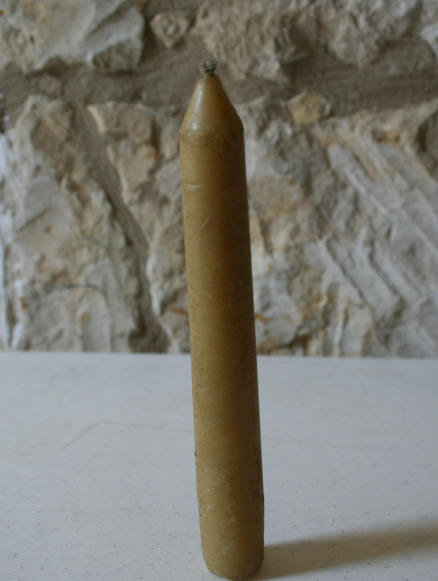
Honeycomb was often melted into beeswax and molded into candles. "The honey-bee seems to have found a favorite haunt in Texas. These industrious insects swarm in great abundance in every district, and beeswax generally sells for one dollar a pound in the cities of Mexico, where large quantities are made use of for candles in the churches. It is common for hunters to secure the wax and throw away the honey as a comparatively trifling value, and so abundant” (Holley, 1990, p. 68).
Candle
Trifling: low
abundant: many

Slide 43
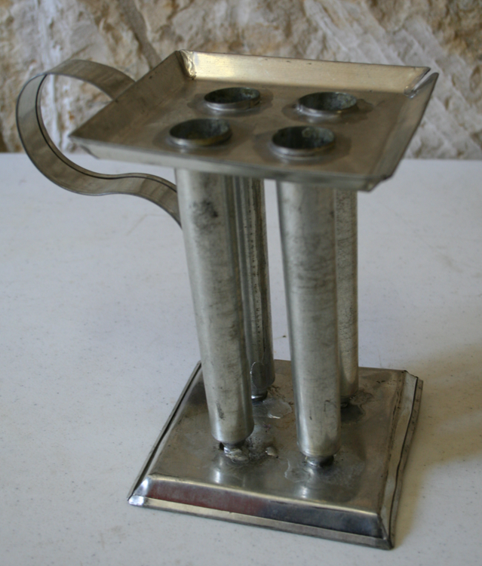
Candle Mold
Beeswax and wicks are the necessary materials for creating candles, and Jemima Toll wrote to her friend in 1832 to be sure to bring “plenty candle wick” (Woodman, 1935, p. 169). That said, more was required in the actual making of beeswax candles.
Candles could be made be pouring hot wax into candle molds prepared with wicks. When the wax cooled and solidified, the candles were removed. Shorter candles could be used in lanterns.
At a party where tallow candles (which were made from animal fat and known for their smell) burned, Dilue Harris records her mother’s exchange where she shares her preference for molded candles with the hostess:
“Mother had candle moulds. She asked Mrs. Dyer why she did not send and get them. Mrs. Dyer said she had never used candle moulds. She and her mother, Mrs. Stafford, used cane, or dipped candles” (Harris, 1900, p. 103).
Wick: a bundle of fibers in a candle

Slide 44
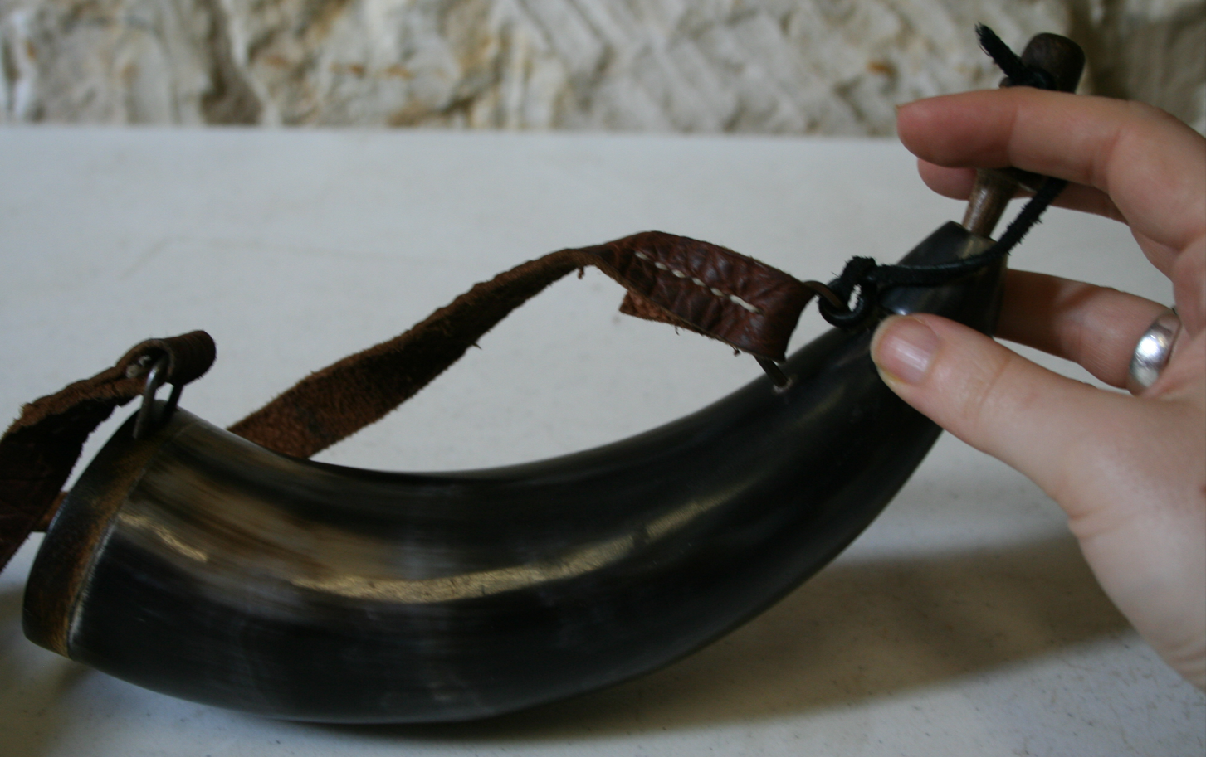
Powder Horn
A common use of cow horn was to create a container for gunpowder called a powder horn. Gunpowder was necessary for the weapons used for both hunting and protection.

Slide 45
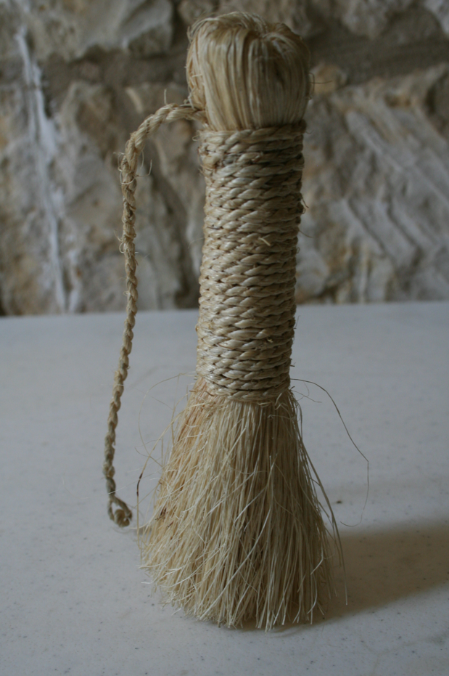
Pot Scrubber
Pot scrubbers were extremely useful. Pot scrubbing rarely makes an appearance in primary sources, but it was a necessary activity. The pot scrubber is a traditional item dated to early Texas, and it is still used in Mexico and Texas today.
The pot scrubber is made by binding together fibers called sisal harvested from the native Mexican agave plant, yet another example of using natural resources.

Slide 46
Flint & Steel
Before the invention of matches, fires were started by striking flint against steel. The resulting sparks were directed toward dried combustible material such as dried leaves or grass, linen tow, or wood shavings.
The process, which required blowing on the embers to fan the flame, proved hazardous to facial hair and may have helped account for the lack of beards and mustaches in this period. Fires were necessary in frontier Texas―they provided warmth and the ability to cook food.
Combustible: material that catches on fire easily
Tow: unraveled strands of rope

Slide 47
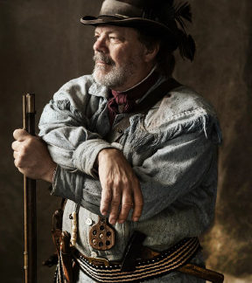
Hand Axe
The hand axe was a multipurpose tool that could be used for everything from personal defense to house building. Mary Rabb’s husband, John, used an axe to clear six acres of their new land. He then cut some of the wood into rails for later use.
“[John] come to the house one Saturday evening leaving axe. . . expecting to return
to. . . work on Monday morning, but as [he] had made a good many rails, the Indians thought it would be a good way to make a pen out of those rails and seize our horses. . . (Rabb, 1962, p. 2―3).

Slide 48
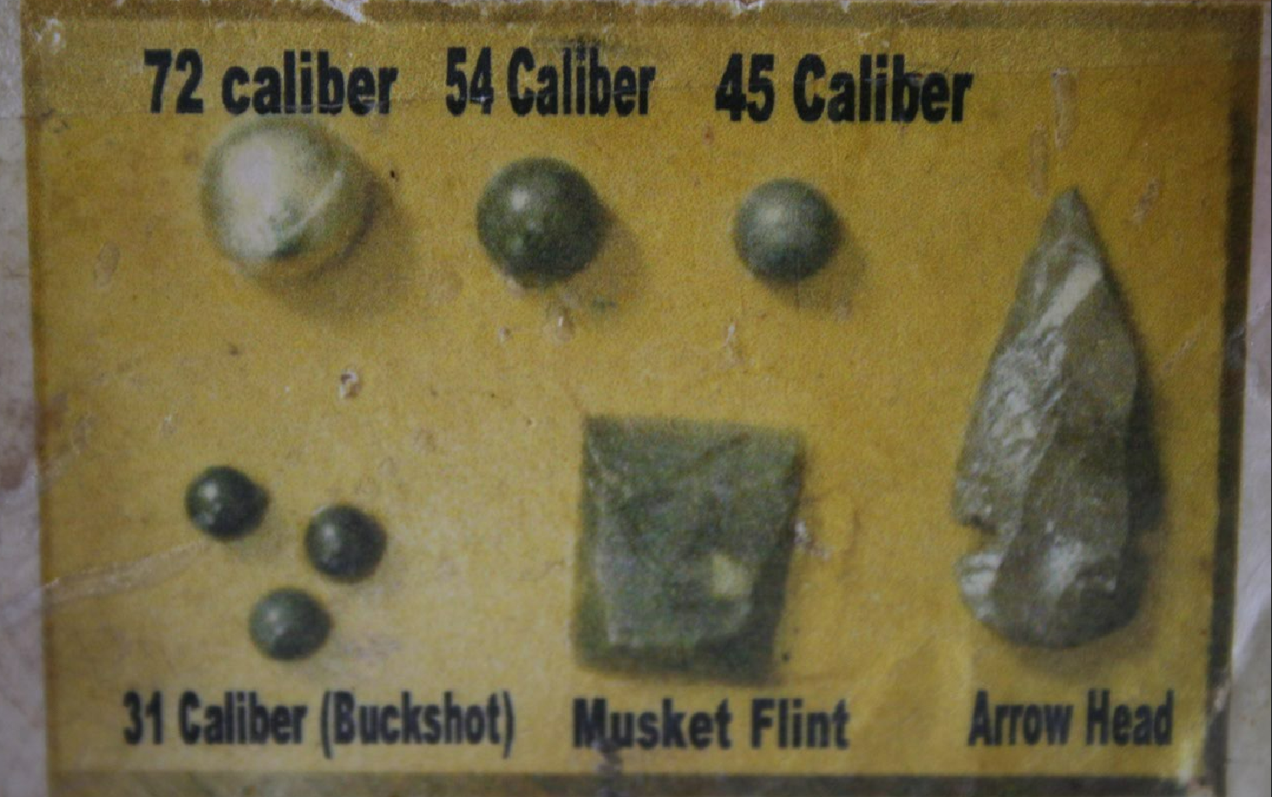
Bullet Block
Weapons used in 1800s Texas would have required gunpowder, a flint, and a bullet, also called a ball. Bullets were made of lead. The bullets on the bullet block illustrate the different calibers. The number of caliber is the diameter of the ball in hundredths of an inch. For instance, 72 caliber is 72/100 of an inch.
The ball size required for a gun was determined by the size of the barrel. Balls were generally made by hand as recounted by Dilue Harris. When her family read one of William Barret Travis’ letters calling for aid at the Alamo in February 1836, they decided to help:
“We worked all day, and mother sat up that night sewing… I spent the day melting lead in a pot, dipping it up with a spoon, and moulding bullets” (Harris, 1901, p. 160).
Before battle, balls were placed in paper cylinders with gunpowder to make cartridges. This made it possible for the soldiers to load their guns more quickly.

Slide 49
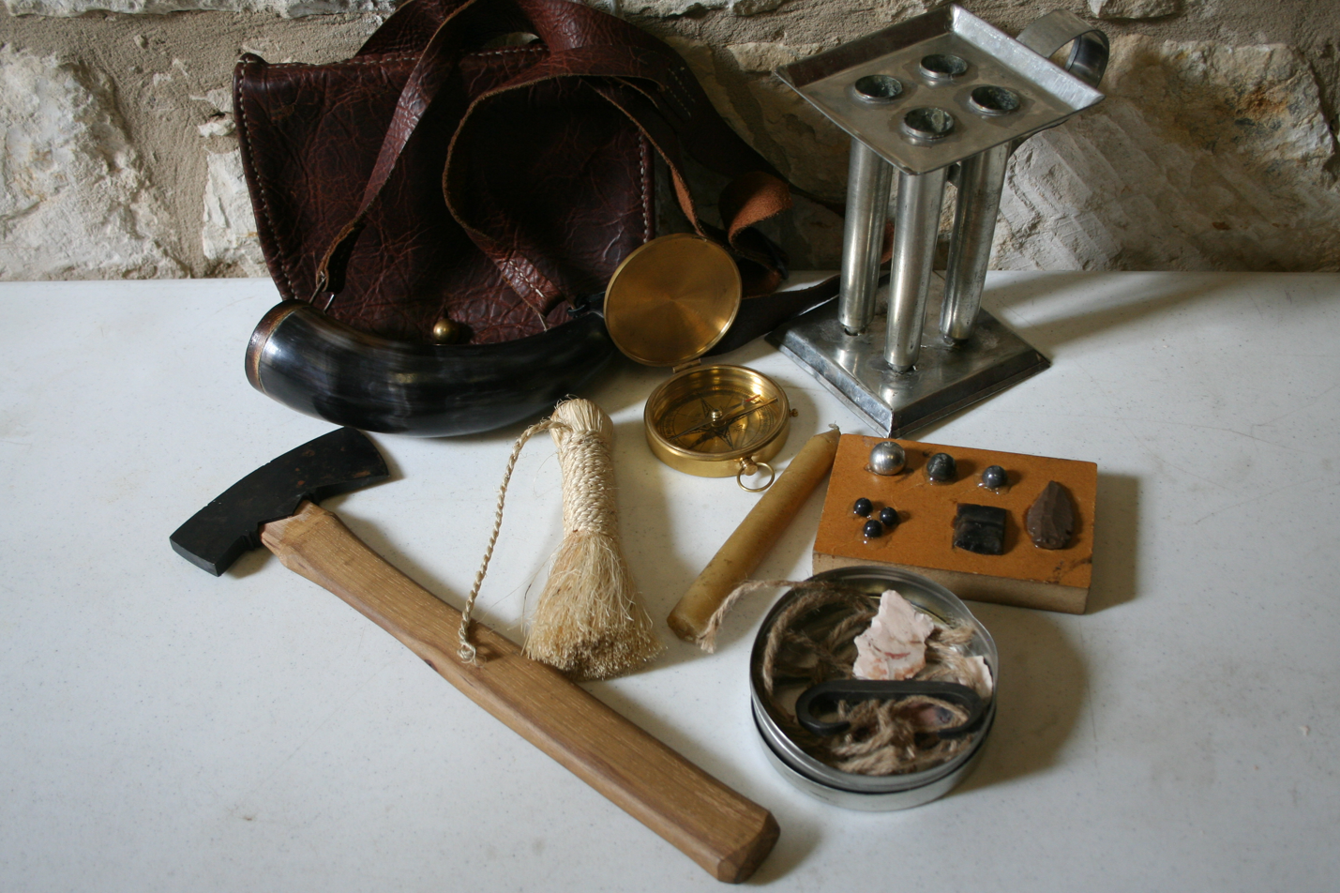
Tools Questions
What three tools do you think are essential on the frontier?
What tools do you use today and how do they compare to the tools of the 1800s?
Which tool do you find to be the least useful? Why?

Slide 50
LUXURY ITEMS

Slide 51
In a world where survival was not assured, time and money could not always be spared for something as simple as a toothbrush.
However, Texans of the past were not without play and fun. They used their imaginations and the offerings of a wild country for enjoyment.
Ingenuity is on display among the items as many of them were created using materials found in Texas.

Slide 52
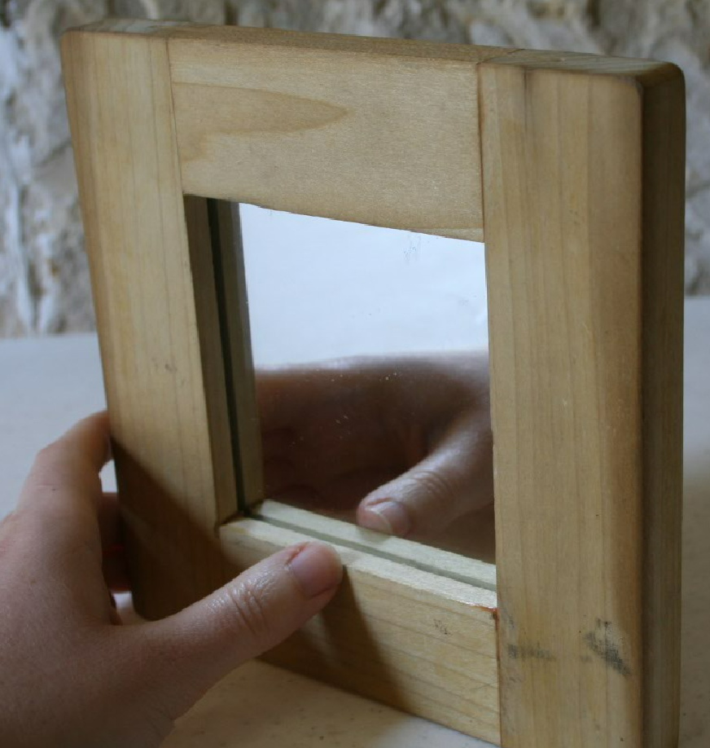
Mirror
The traveling mirror is made for a soldier to carry on marches. Designed for shaving, a mirror would have certainly been a luxury. As soldiers were required to carry their own gear wherever they went, limiting the weight of the pack was important. A breakable mirror would likely have been one of the first items to be removed to lighten the load.
Mirrors were also used as an item of trade with Indigenous communities. In a letter to the governor of Texas in 1808,
“two hundred and fifty dozen hand-mirrors ‘wood or metal-backed” were recommended to help advance relationships with the local Comanches
(Guice, 1957, p. 509).

Slide 53
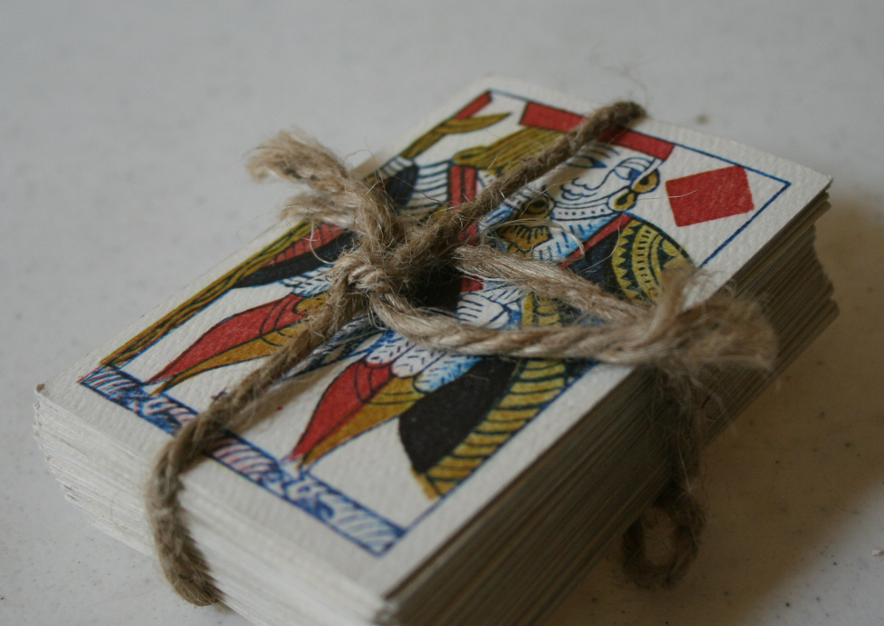
Playing Cards
Playing cards came to the Americas via Europeans. A feature of modern playing cards was the addition of numbers―the cards included in the trunk aren’t numbered as would have been the case in frontier Texas.
In polite society, card playing was a parlor game intended for entertainment. On the frontier, however, card playing was often associated with gambling. When George Kendall visited a fandango in San Antonio, he:
“passed through an open door, leading into a back room, where were a small party of men and women betting at monte. I lost a couple of dollars just to get the hang of the game. . . and then retired to my lodgings” (Kendall 2004, p. 19).
Monte: a card game

Slide 54
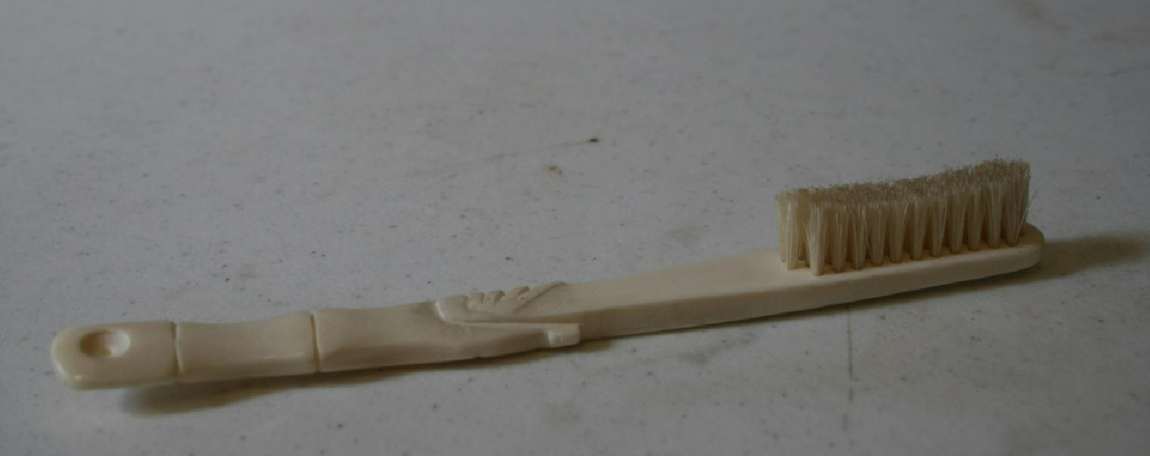
Toothbrush
Toothbrushes were commercially available in Texas during this time. Manson and Bailey, a dry goods store in Brazoria, advertised toothbrushes amongst their other items in The Texas Republican newspaper in 1835 (Manson & Bailey, 1835.) The handles were usually made of bone or wood; the bristles were made from stiff hog hair. Wood ash was used as a tooth powder, the equivalent of toothpaste.
Pioneers were at least aware of the importance of dental health as William Marcy recommended taking two toothbrushes on a three-month expedition (Marcy, 1993, p. 39).

Slide 55
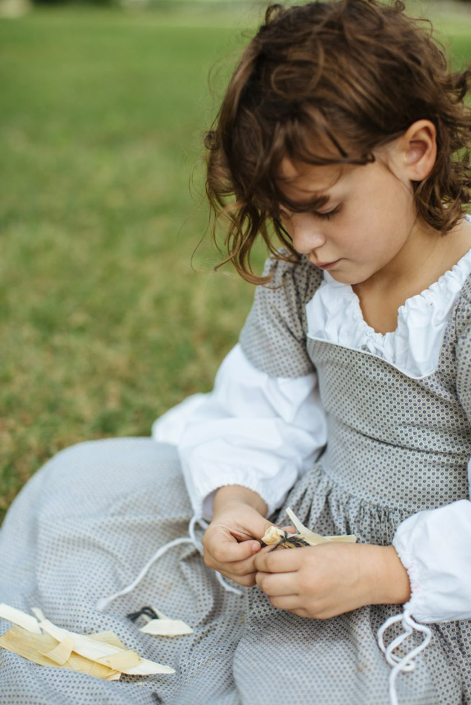
Corn Husk Doll
Even if parents of pioneer children had money to use on toys, it would have been a difficult task to find a store selling these items. This did not keep children from playing―they simply made their own toys. Ida Hall recalled her childhood in frontier Texas and spoke of children who:
“rode stick horses and see-saws, swung on trees. . . Rolled hoops. [and] . . . made dolls of rags and corn shucks” (Dobie, Boatright, & Ransom, 1941, p. 141).
Making dolls from corn husks was a simple option using one of the few known materials in Texas, corn. Corn husks are what corn is wrapped while growing on the stalks. The husks would be green while living, after stripped from the corn, the husks turn yellow and dry. These could be soaked and shaped into a doll.
A popular toy that a child who lived in Texas during the early 1900s recalled that
“I used to help my sisters make some of their dolls. We lived on a farm near Trent in Taylor County. It must have been about 1918, when I was twelve years old, that I made my first one” (Abernethy, 1989, p. 67).

Slide 56
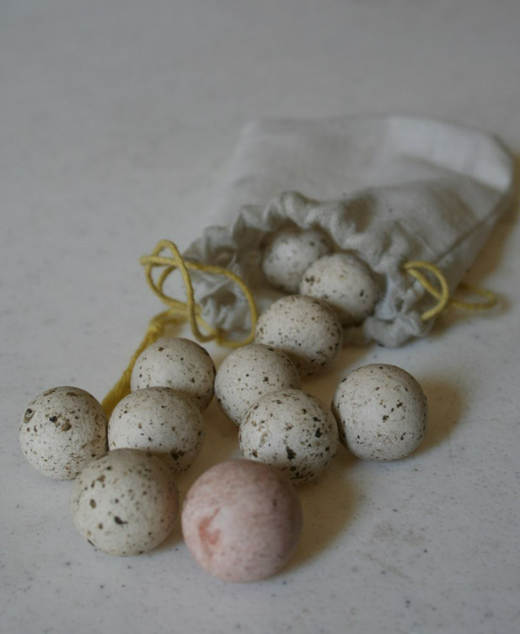
Marbles
Crock marbles, or marbles made from clay, were popular toys in the 1800s. They were simple to make and easy to use in games (Abernethy, 1989).
For examples of marble games played in Texas, reference Texas Toys and Games here:
https://texashistory.unt.edu/ark:/67531/metadc67661/m1/160/?q=marble

Slide 57
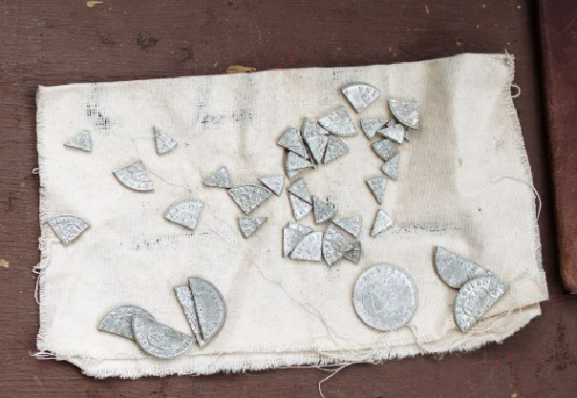
Coins
Paper money had not yet come into popular use in the 1800s. Money, to most people, was gold or silver coins called specie. The Spanish silver dollar, also known as a real (pronounced ray-ahl), peso, or piece of eight) was accepted as legal currency in the U.S. until the 1850s.

Slide 58
Dice
While in camp, soldiers would play games and gamble using dice. Dice could be made of wood, bone, or lead, and the markings are the same as dice used today. Soldiers sometimes hammered musket balls into cubes, marked them with the appropriate dots, and used them as dice.

Slide 59
Lice Comb
Combs of the period often had two different sides- one for regular combing and the other was for combing out lice (vermin), indicating that lice were a common problem.
John Shackelford, a survivor of the Goliad massacre, wrote of this problem. He was spared by the Mexican army because they needed help in their hospital. He wrote of this time,
“our situation at this time was truly deplorable; having everything stolen from us but the clothes on our backs; having little or no food, and that of the most revolting kind;- covered with vermin, worn down with fatigue, and a prey to the most heart- rending forebodings” (Foote, 1841. p. 245).
Spared: allowed to live
Deplorable: bad in quality
Forebodings: a feeling that something bad will happen.

Slide 60
Luxury Items Questions
Do you use anything like these objects today? If so, do you consider it a luxury? Explain your answer.
Put the luxury items in order from most to least desired. Explain your reasoning.
What other luxury objects do you think were used in the 1800s?

Slide 61
Read more about Alamo History Trunk objects in the Handbook For Teachers located on our website.
https://www.thealamo.org/educators/history-trunks
For questions or feedback, please email education@thealamo.org

Slide 62
www.theAlamo.org

